Slide 1
HabitLab: In-the-wild Behavior Change Experiments at Scale
Geza Kovacs
Stanford HCI Group
Notes:
II

Slide 2
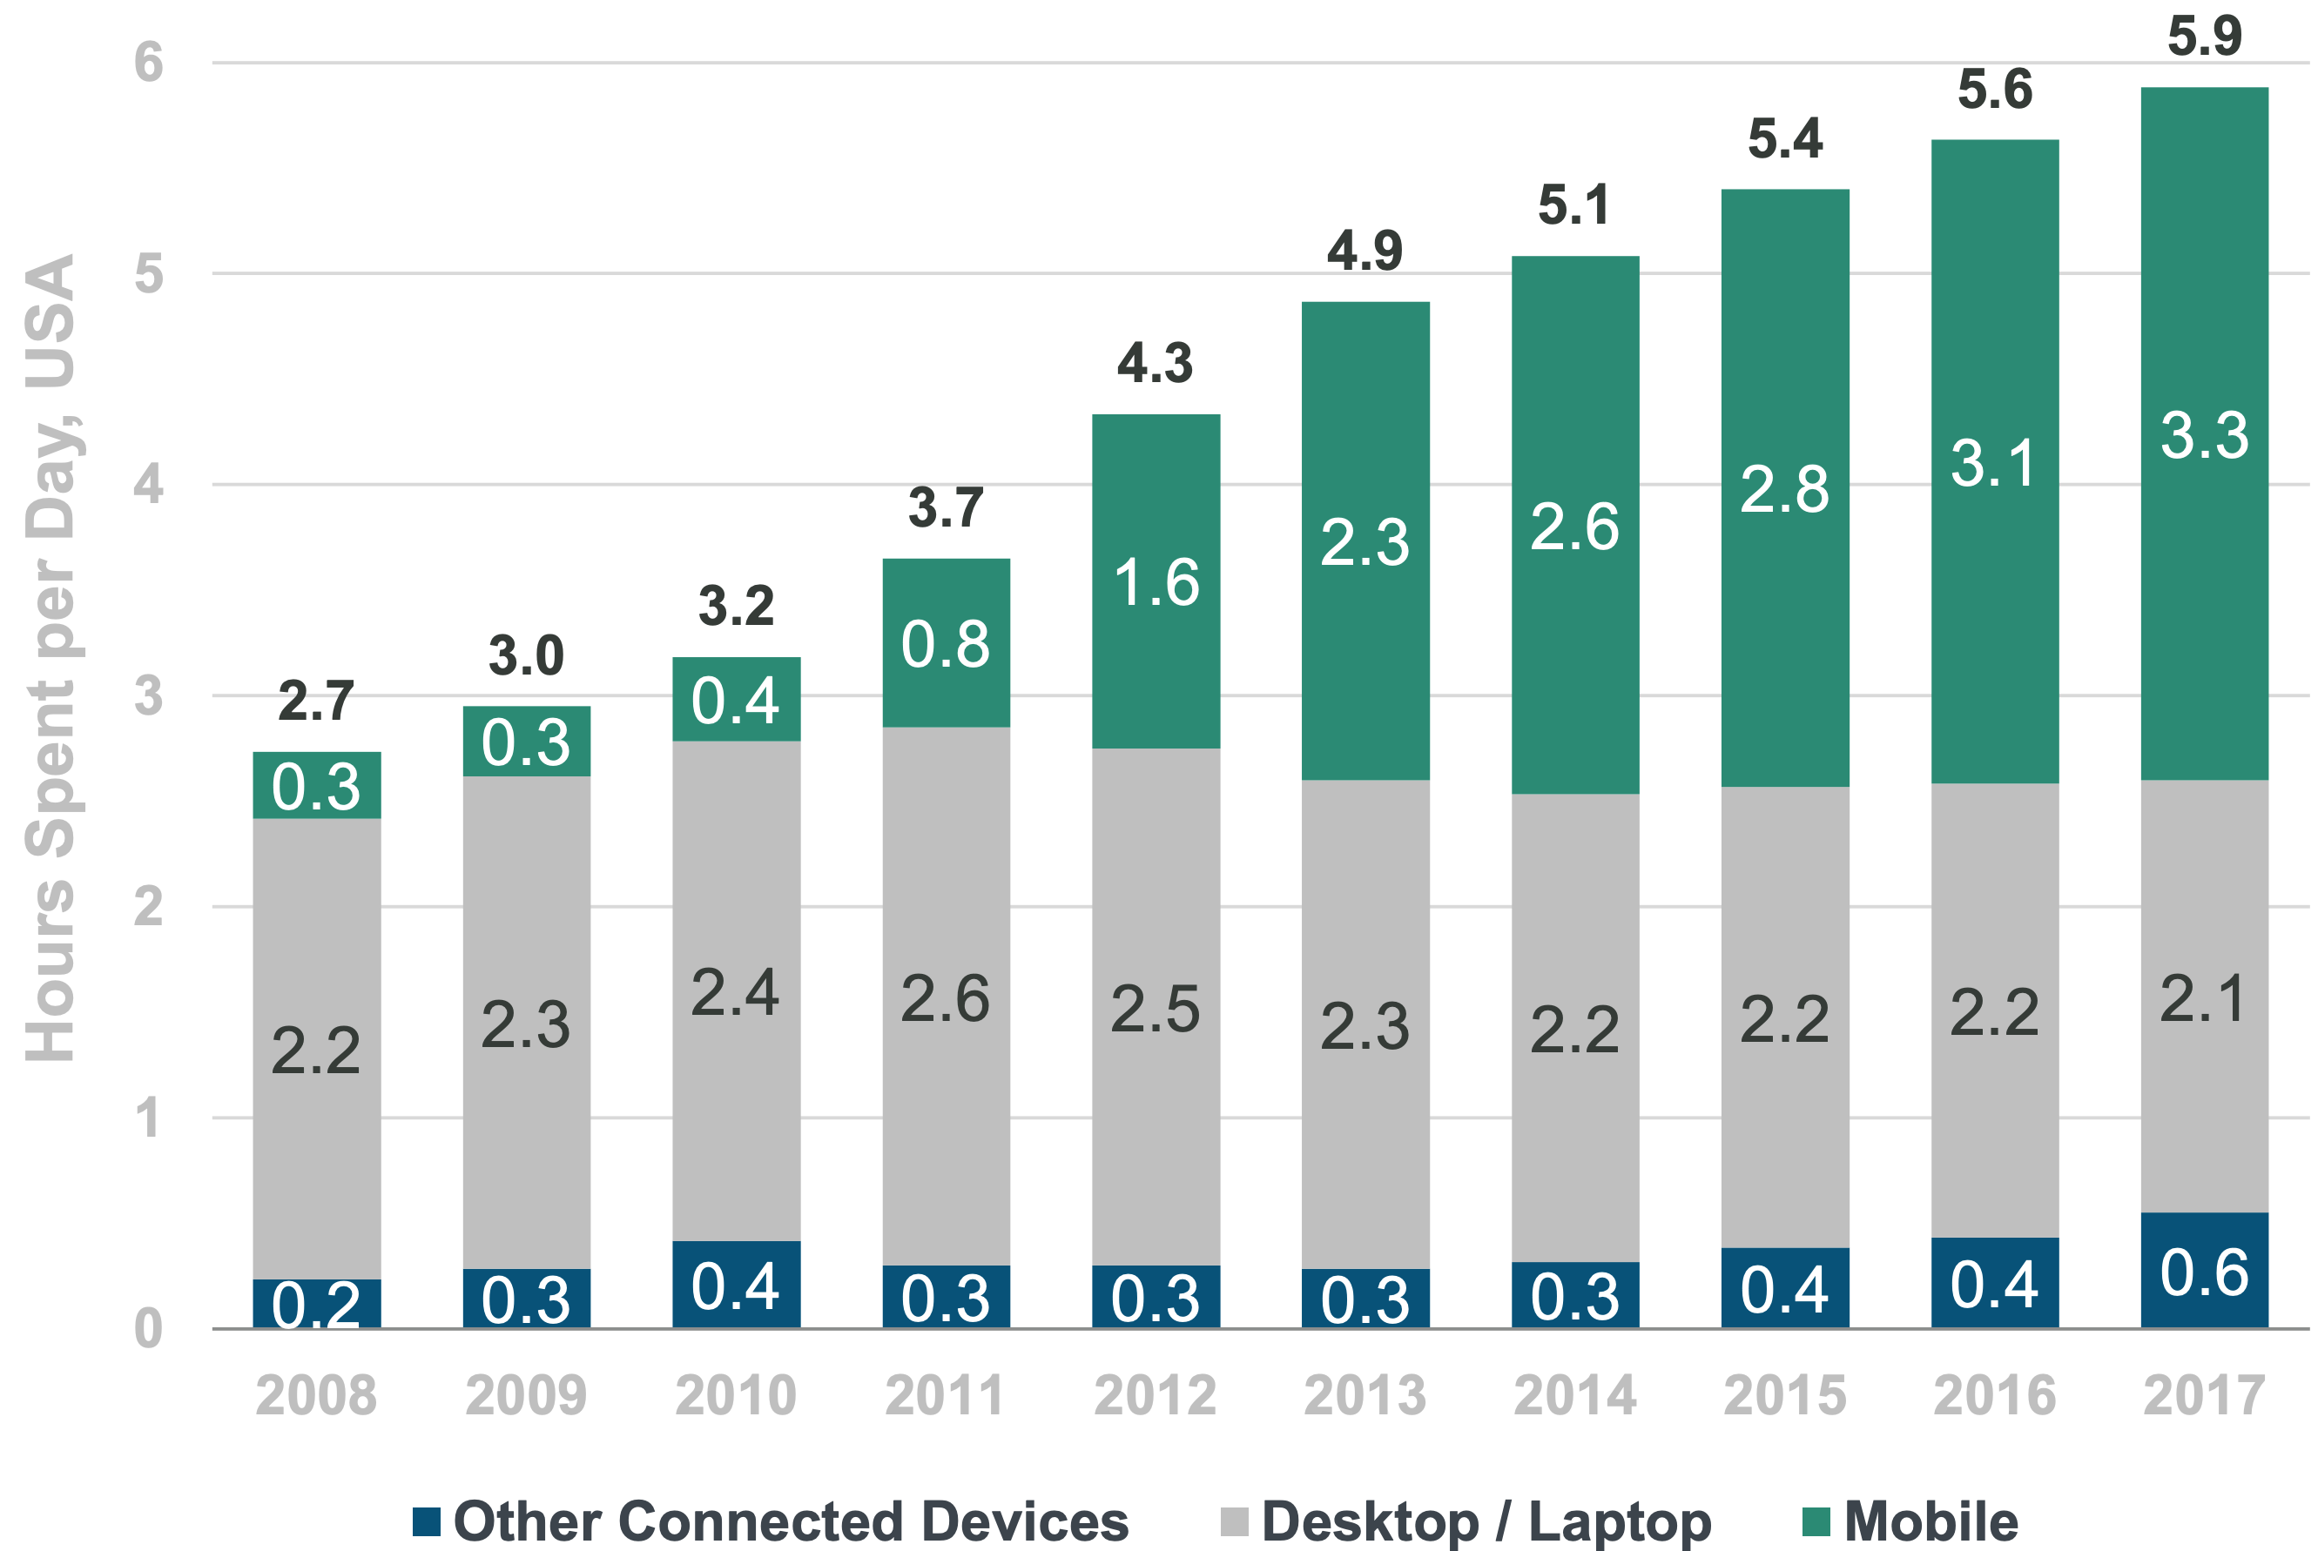
People spend increasing amounts of time online
Average US adult spends 5.9 hours per day with digital media
Source: Kleiner Perkins 2018 Internet Trends

Slide 3

People struggle to reduce their time online
Kim, Young-Ho, et al. "TimeAware: Leveraging framing effects to enhance personal productivity." Proceedings of the 2016 CHI Conference on Human Factors in Computing Systems. ACM, 2016.
Andreassen, Cecilie Schou, et al. "Development of a Facebook addiction scale." Psychological reports 110.2 (2012): 501-517.

Slide 4
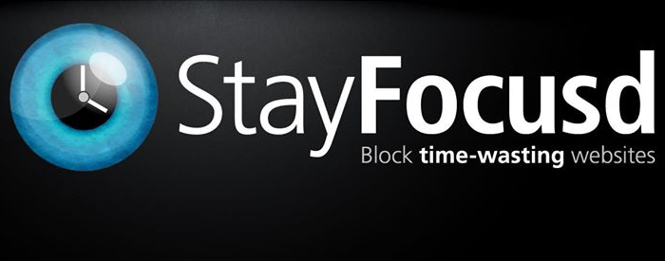

Users use productivity tools to help them reduce time online

Slide 5
Interventions and resulting outcomes
If your goal is to spend less time on Facebook
Intervention
Outcome
Block Facebook
Time on Facebook decreases

Slide 6
Online behavior change is a domain well-suited for studying interventions and outcomes
Outcomes
Interventions
Can measure outcomes precisely (time spent on each site each visit)
Many interventions possible
Can adapt interventions quickly (new one each visit)

Slide 7
Current productivity tools make assumptions about interventions and outcomes
Assumptions about outcomes
Assumptions about interventions
Effectiveness persists over time
There are no negative externalities
A single intervention can meet most needs
Users are good at predicting what interventions will work for them

Slide 8
We developed HabitLab to study whether these assumptions are actually true
Questions about outcomes
Questions about interventions
Does effectiveness remain constant over time?
Do externalities exist?
Does a single intervention meet most needs?
Are users good at predicting what interventions will work well for them?

Slide 9
HabitLab: Our in-the-wild behavior change platform
Outcomes
Does effectiveness remain constant over time?
What externalities exist?
Interventions
How do users’ preferences change over time?

Slide 10
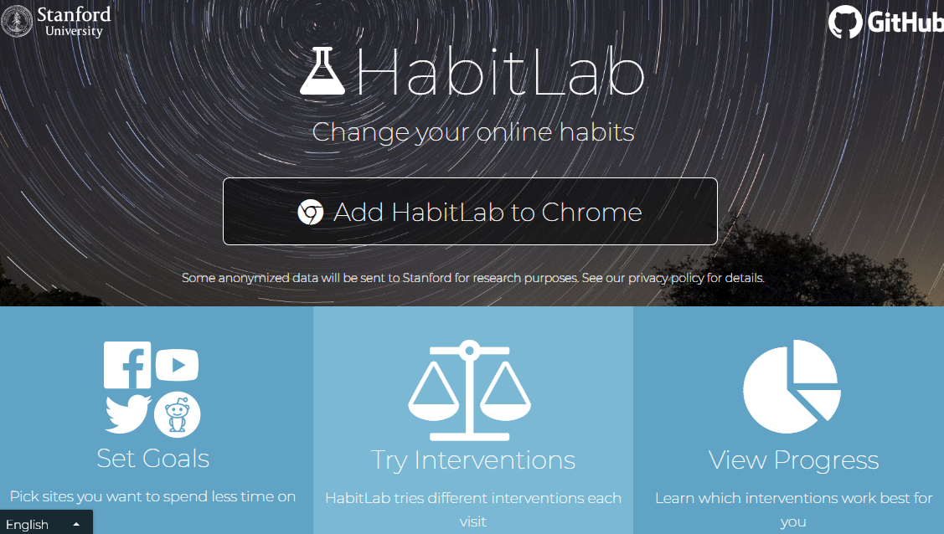
HabitLab
Our behavior change platform
12,000+ in-the-wild active users (Browser+Android)

Slide 11
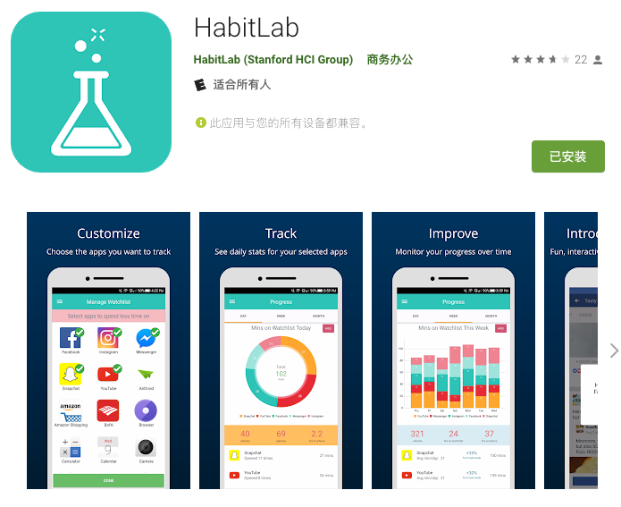
HabitLab
Our behavior change platform
12,000+ in-the-wild active users (Browser+Android)

Slide 12
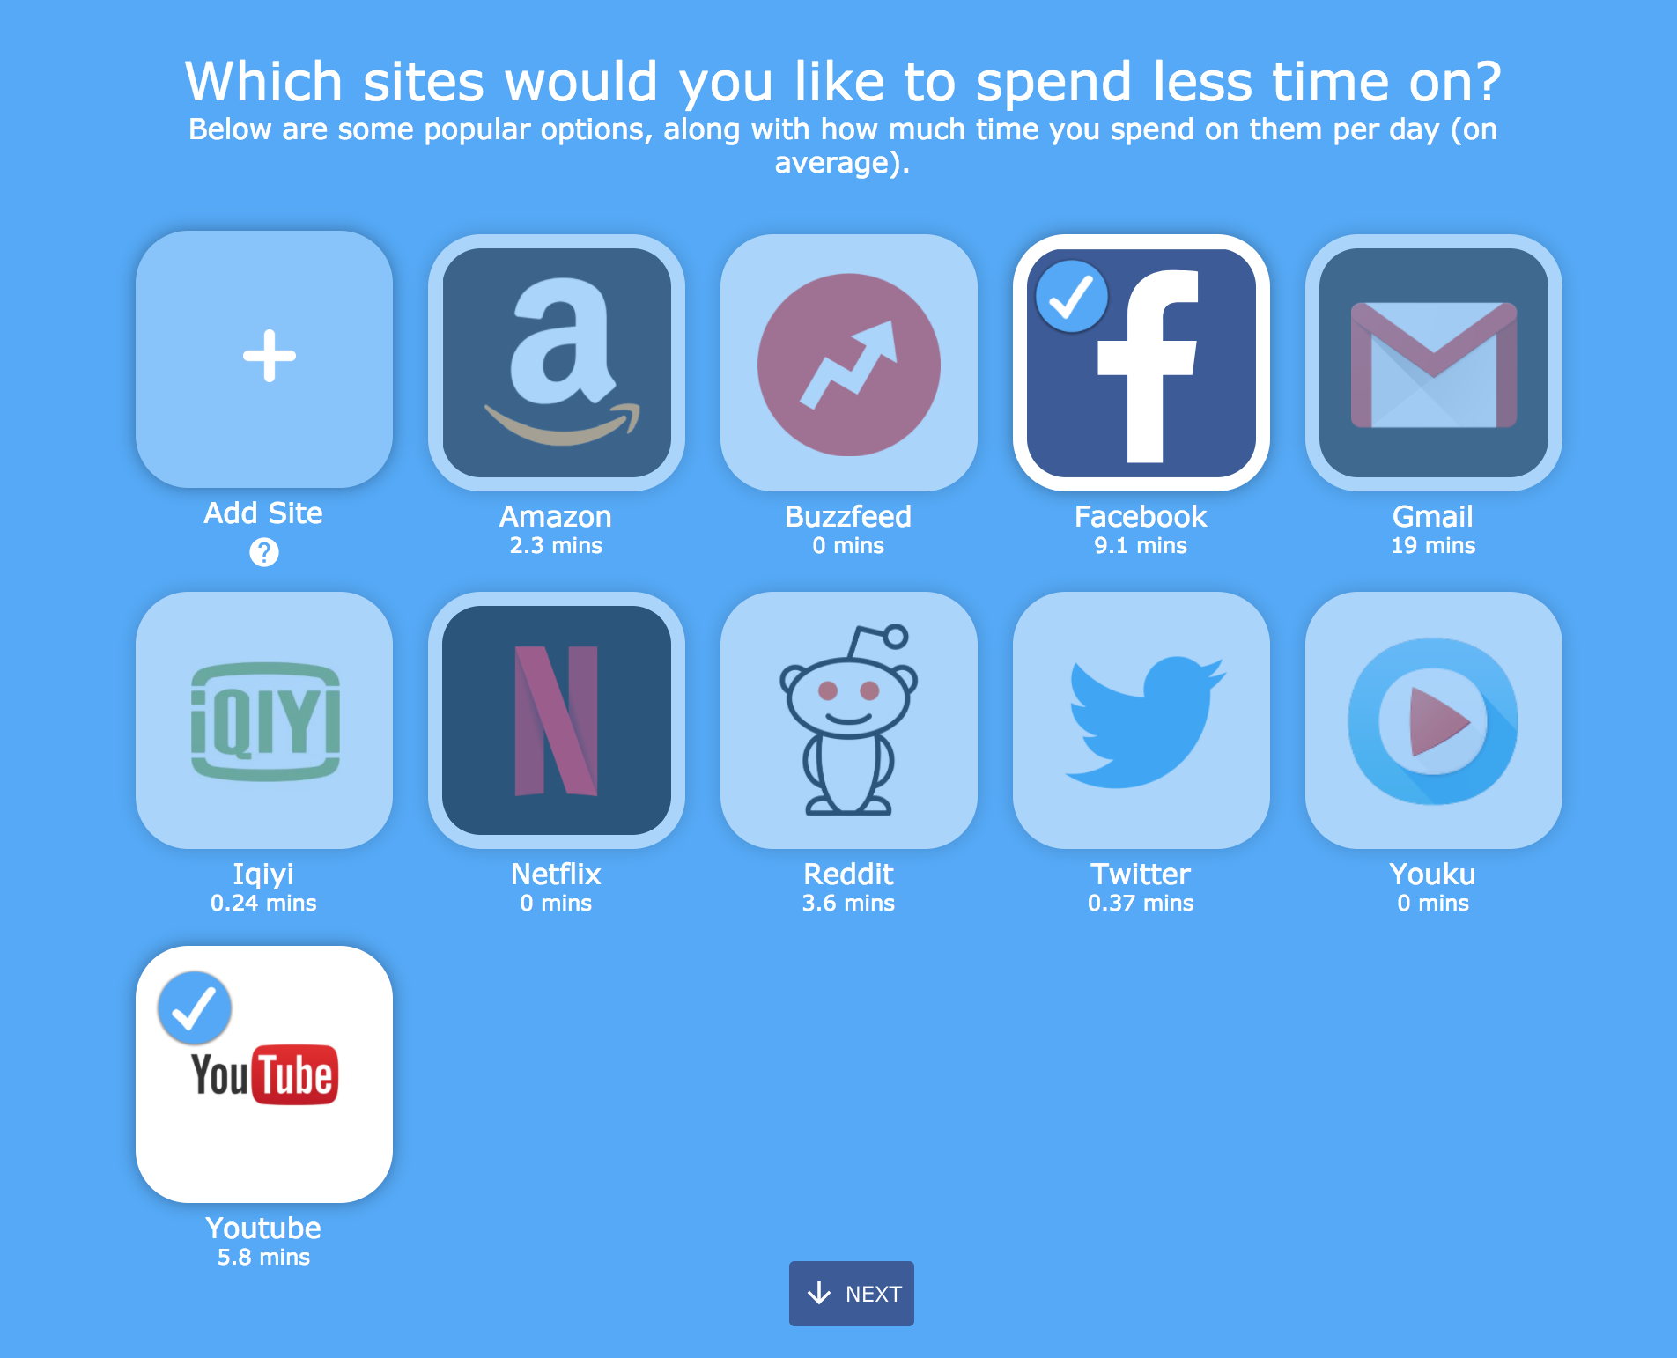
Users select sites or apps to reduce time on (goals)

Slide 13
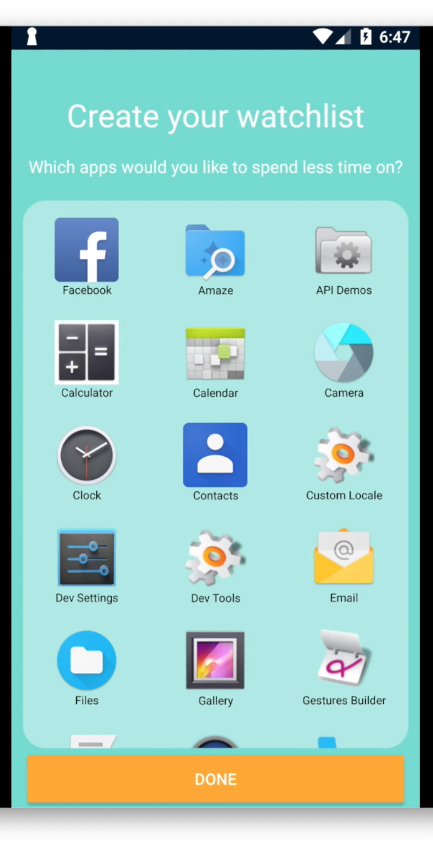
Users select sites or apps to reduce time on (goals)

Slide 14
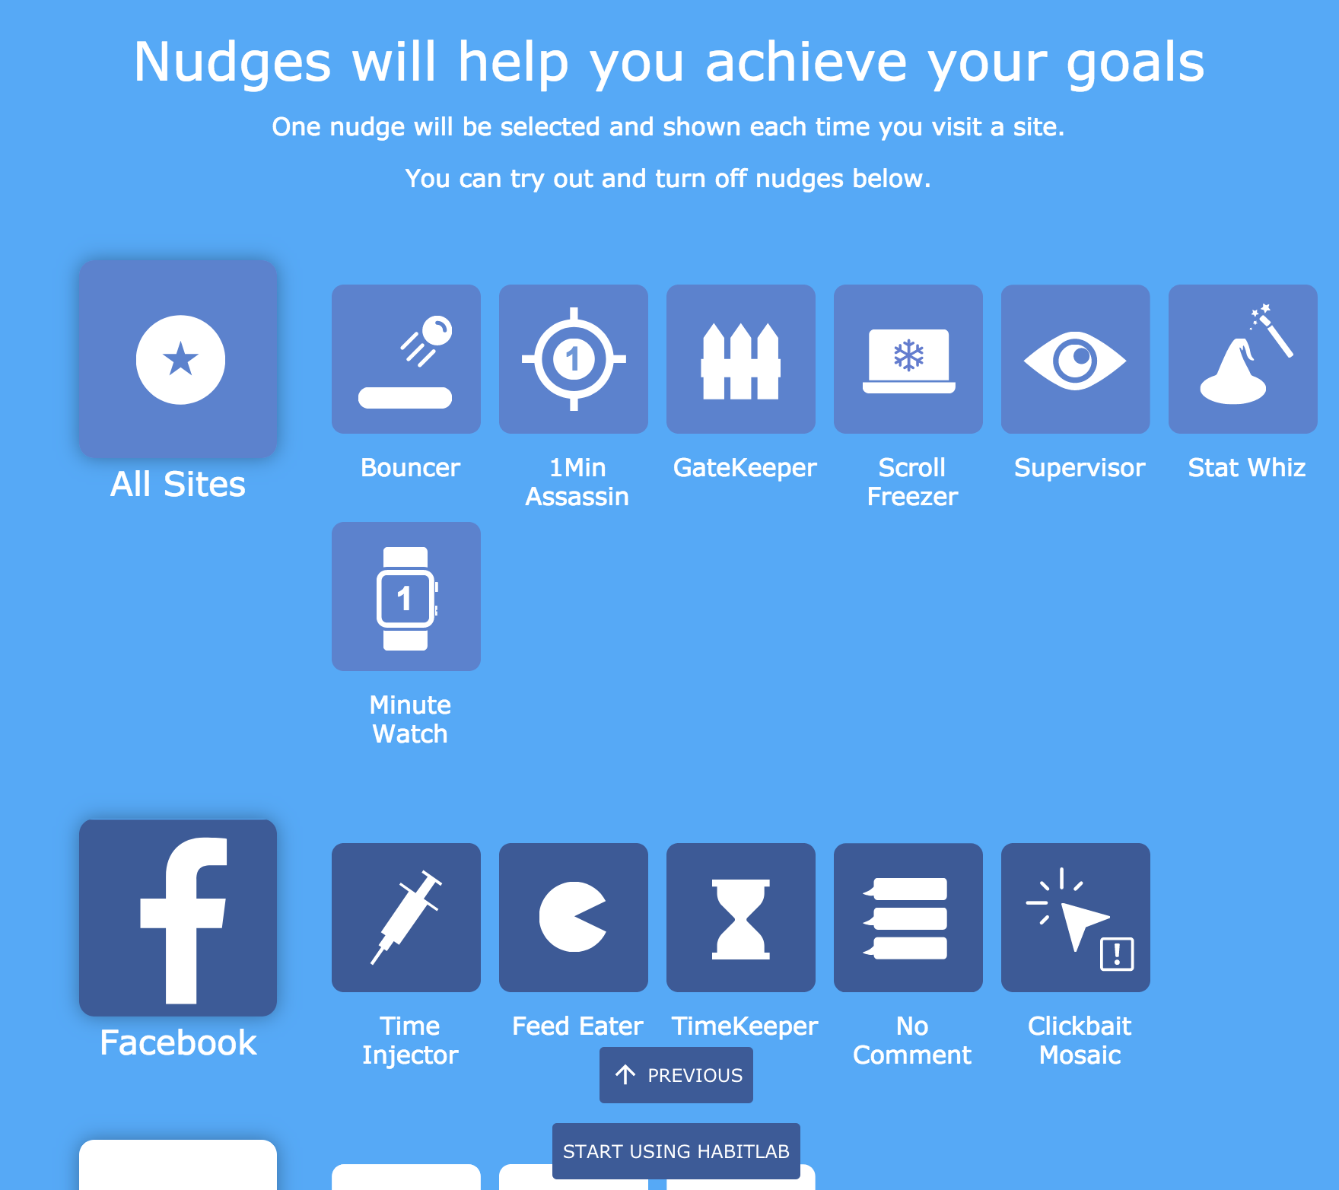
Interventions help reduce time on goal sites and apps

Slide 15
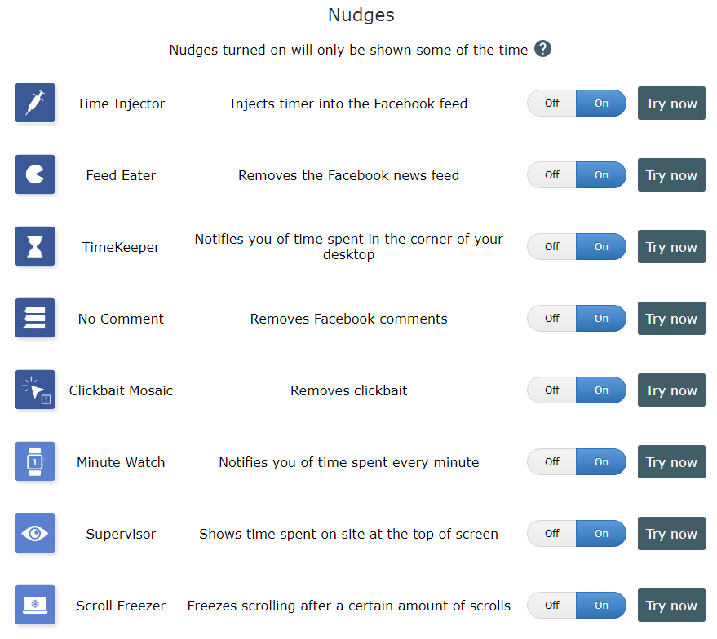
30+ interventions available

Slide 16
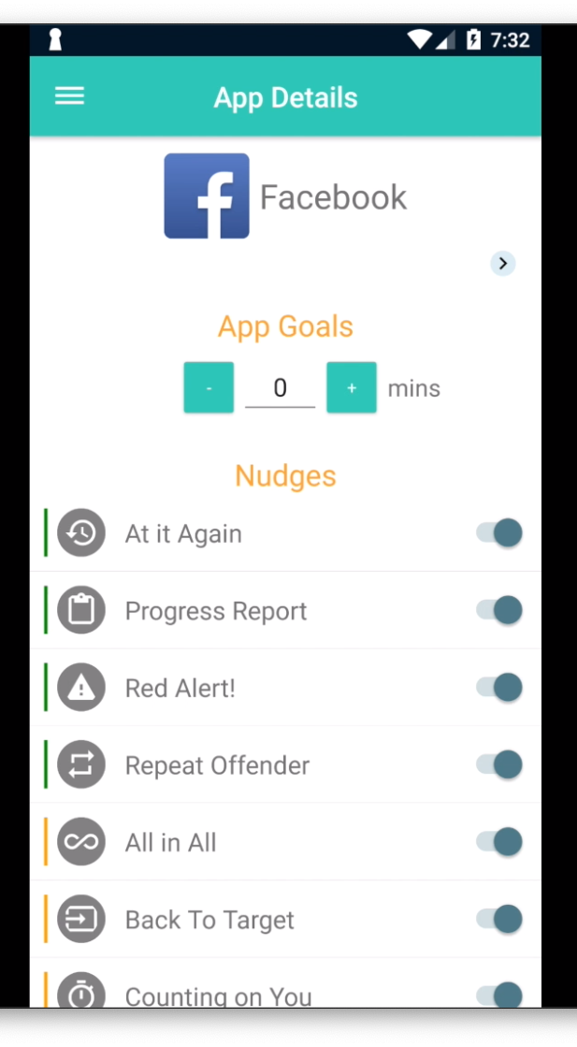
30+ interventions available

Slide 17

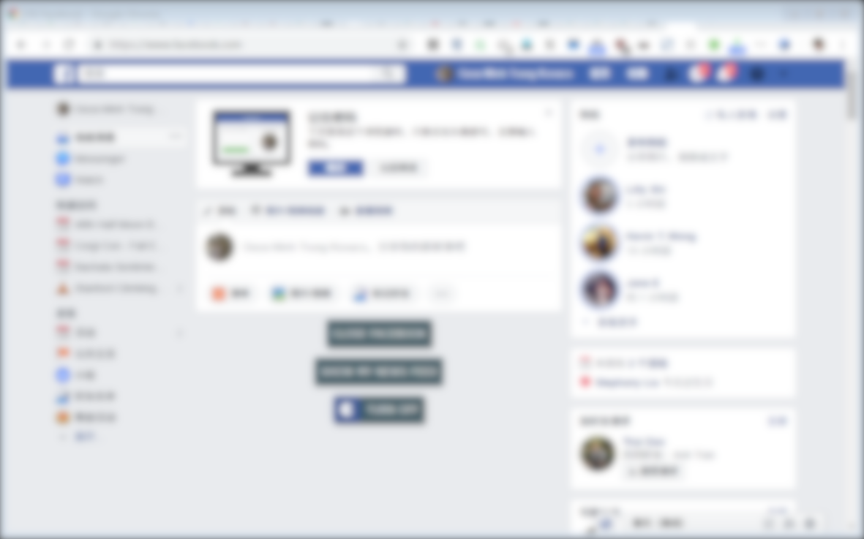


Slide 18
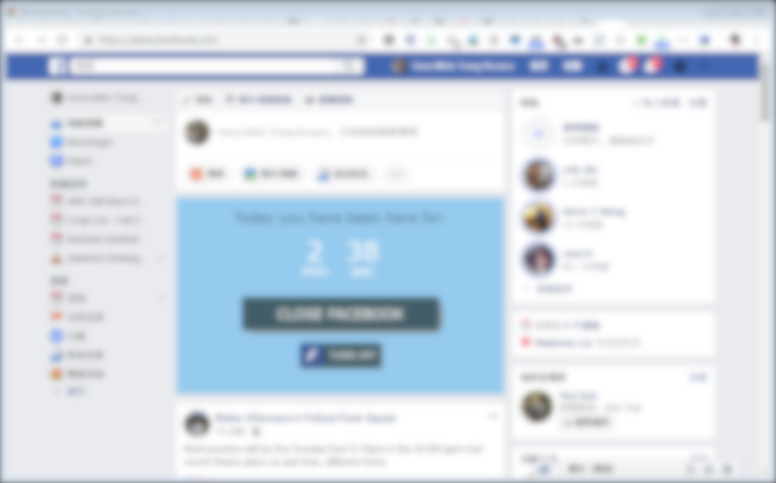
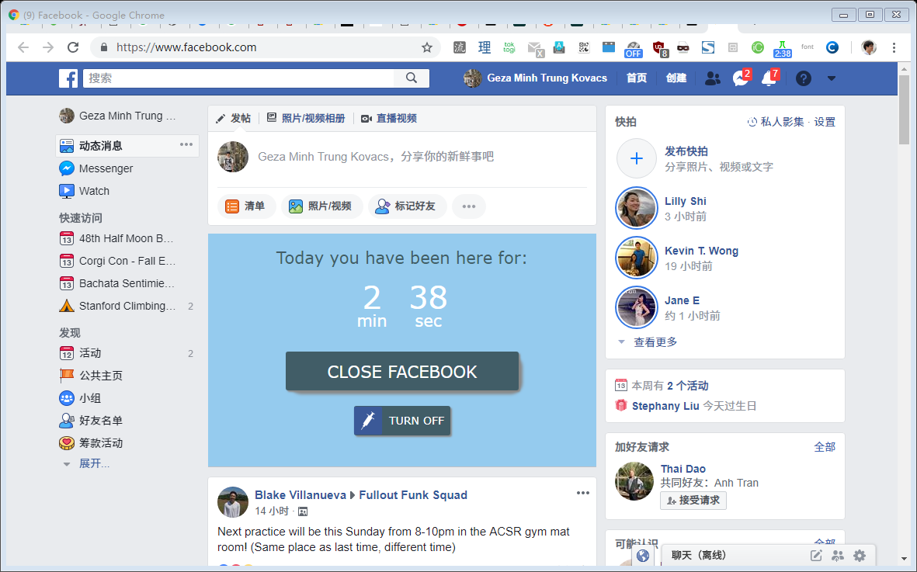

Slide 19
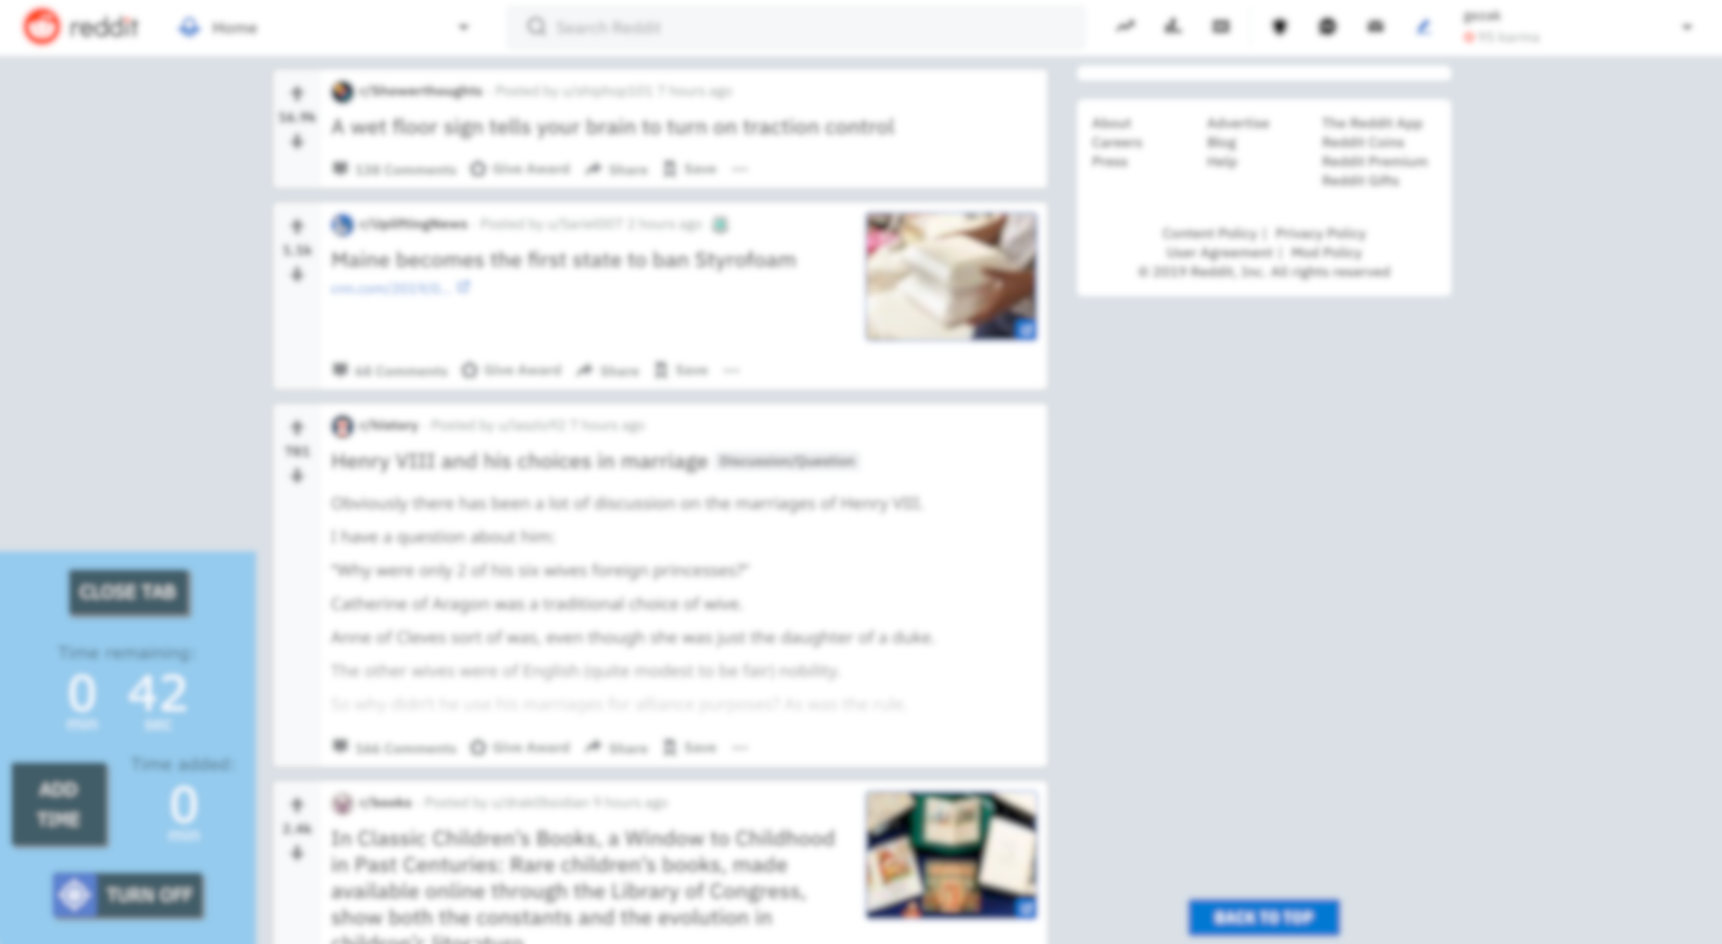
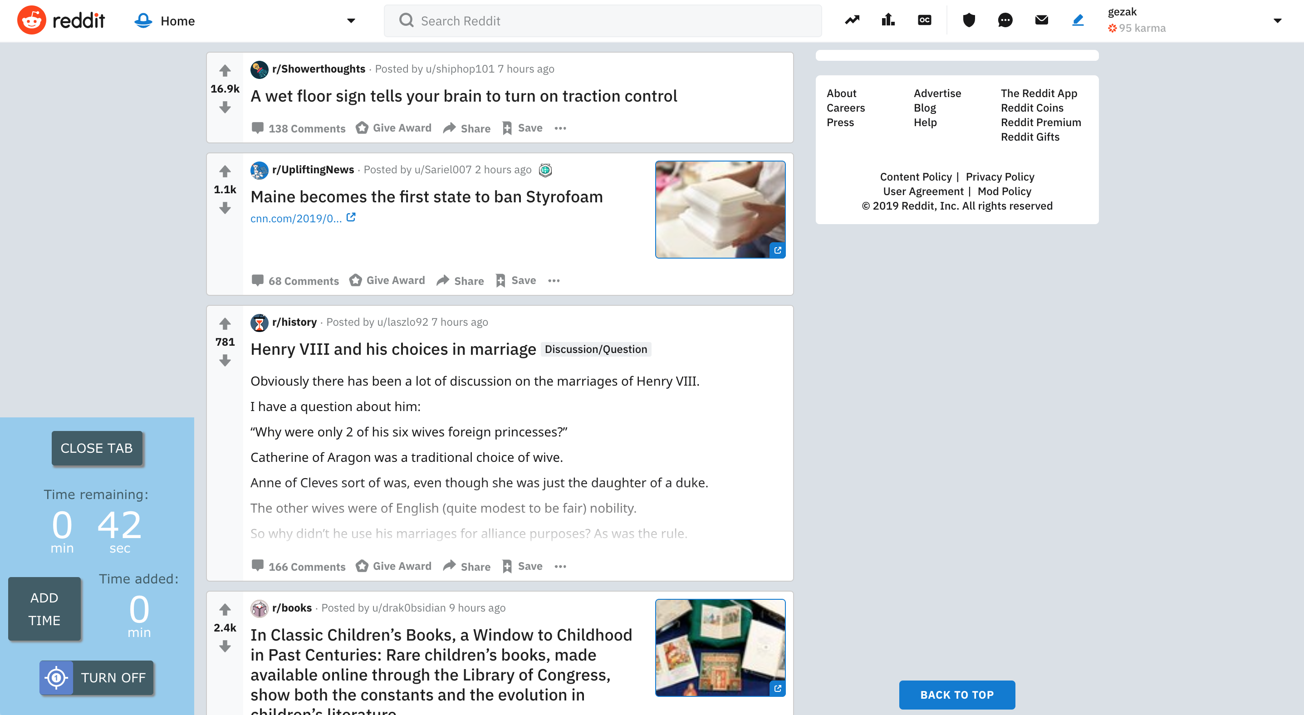

Slide 20
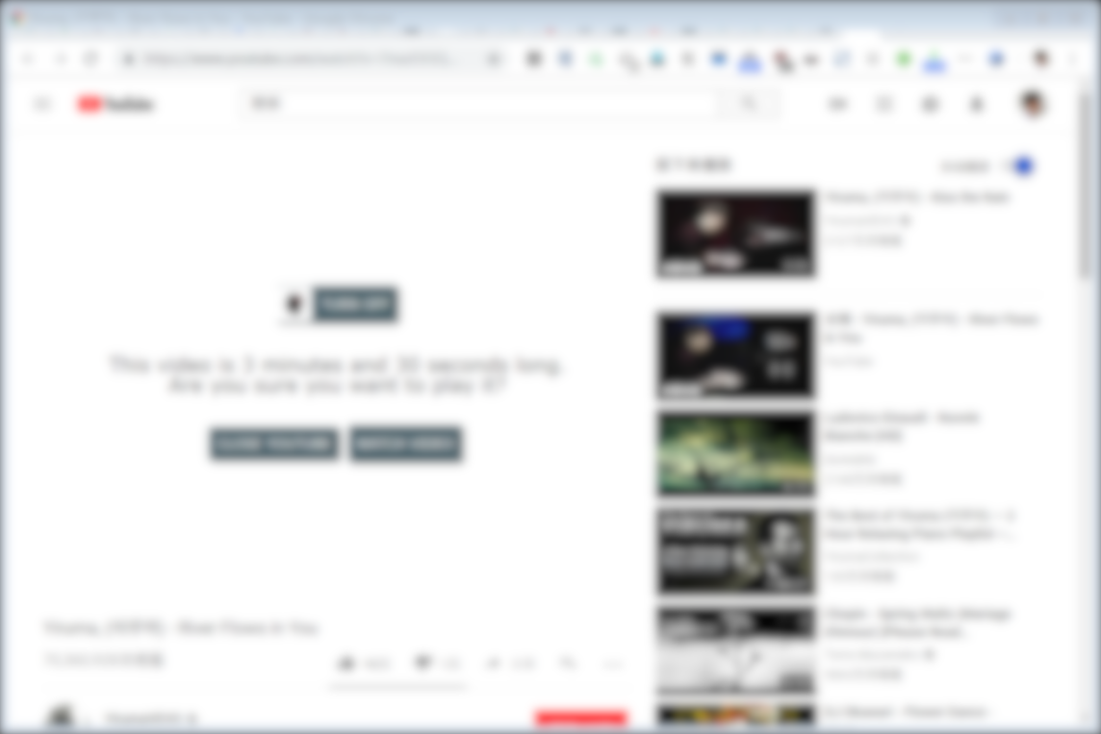
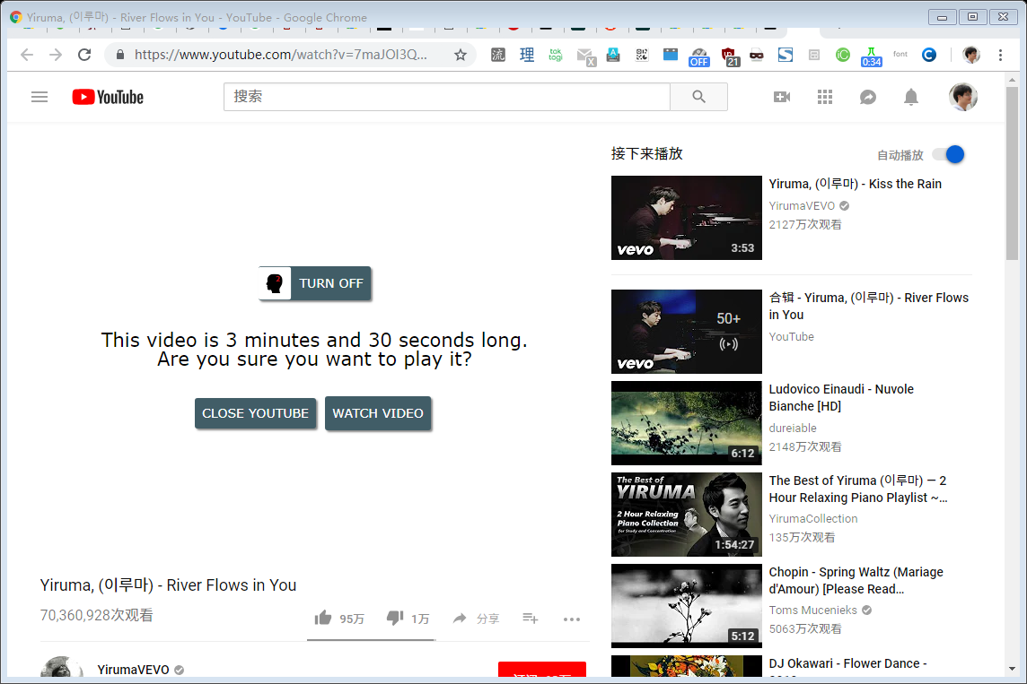

Slide 21
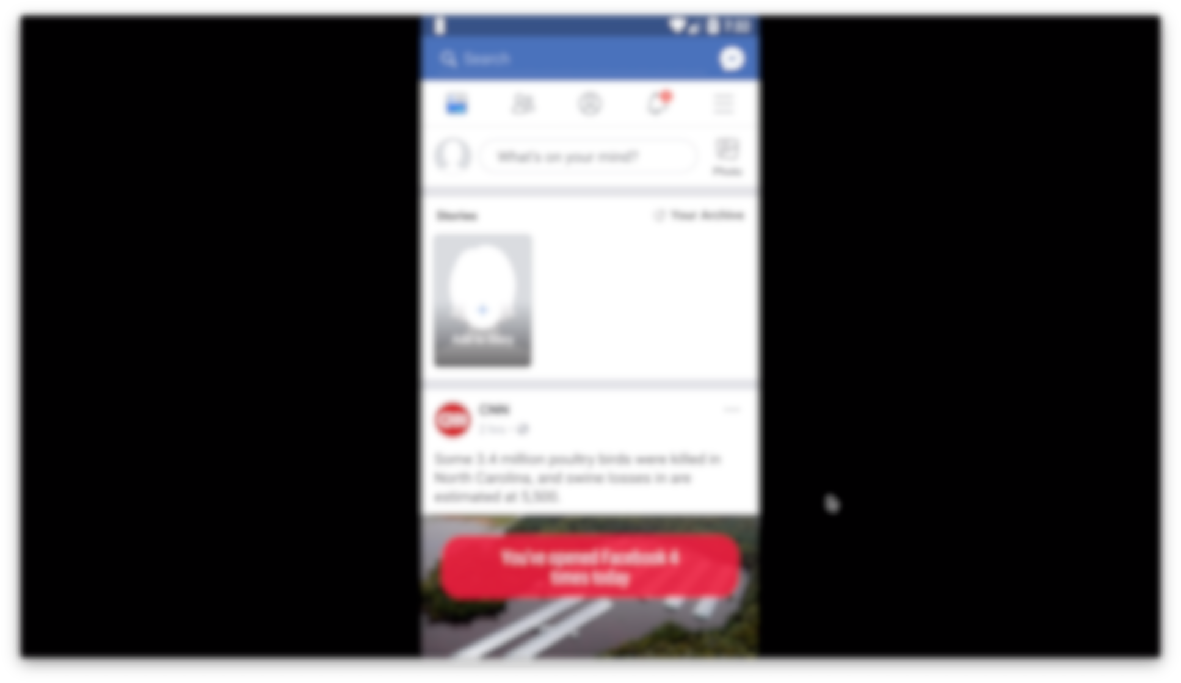
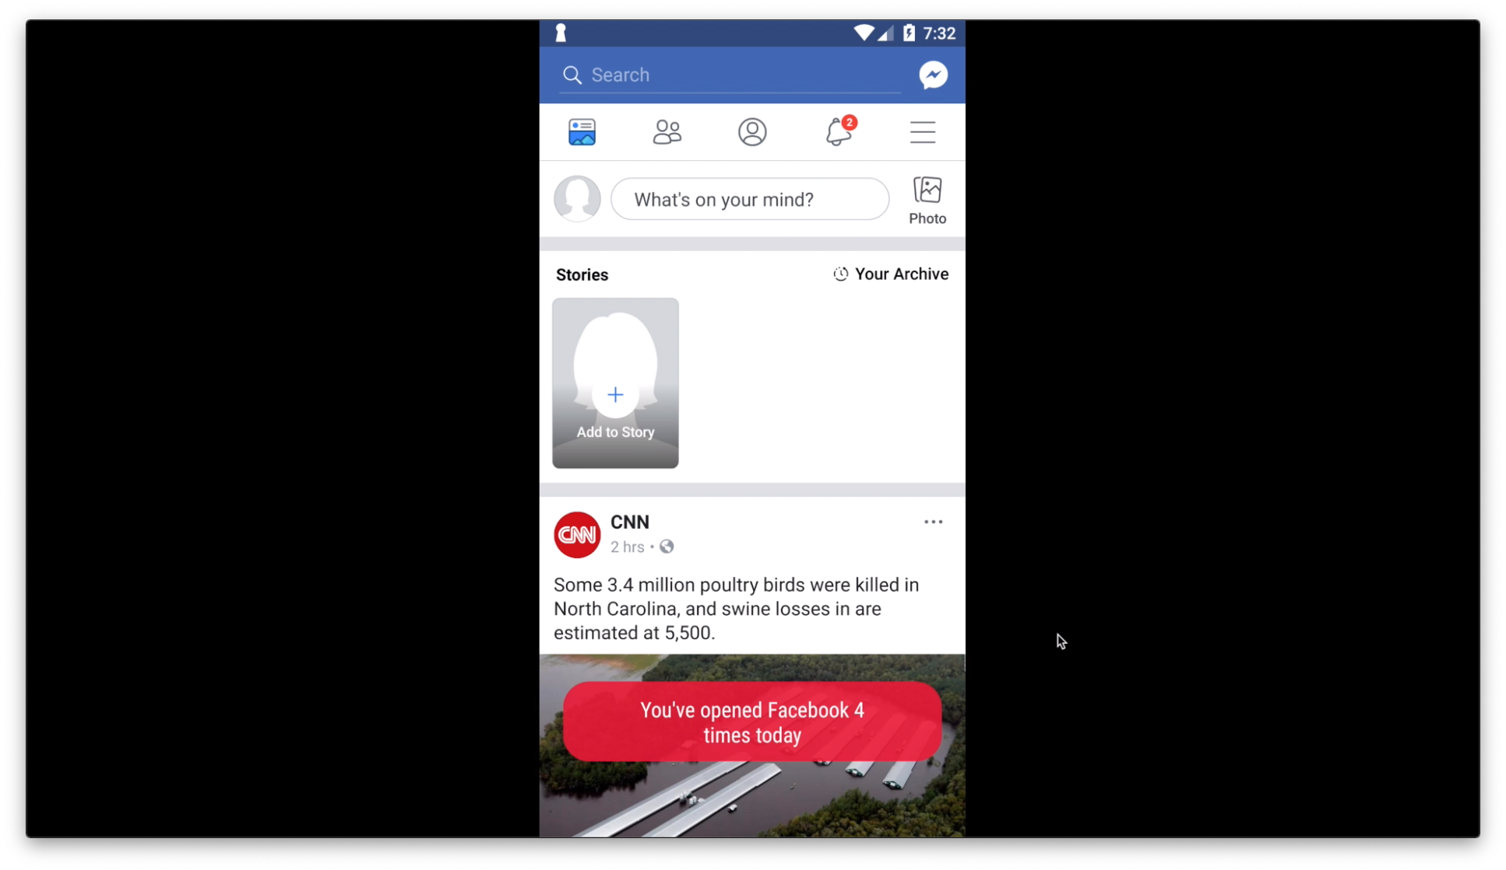

Slide 22
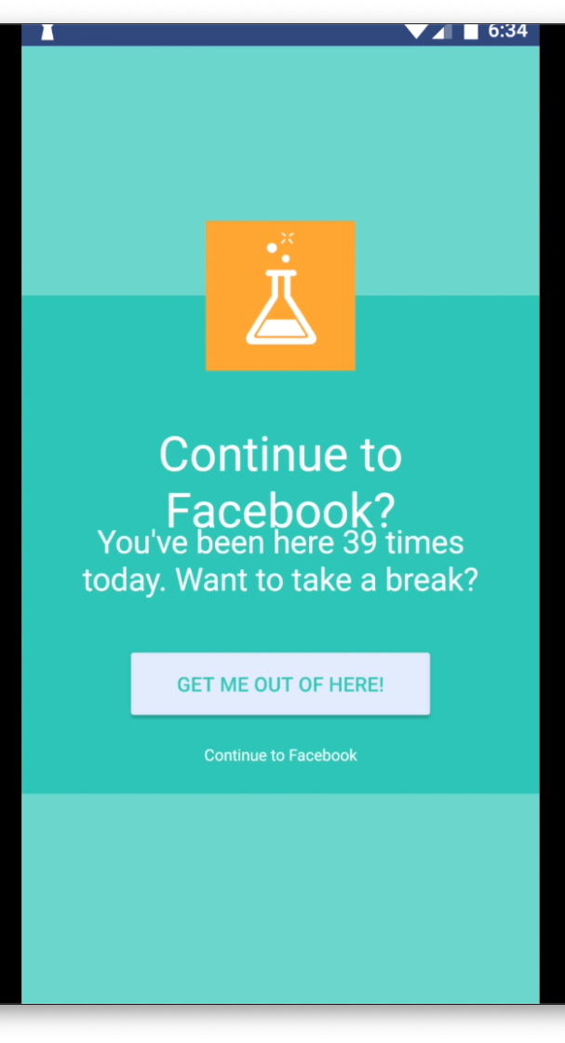

Slide 23
Design process for interventions
Existing interventions on the Chrome Store
Ideas proposed by experts and users
Adaptations of techniques from the literature

Slide 24
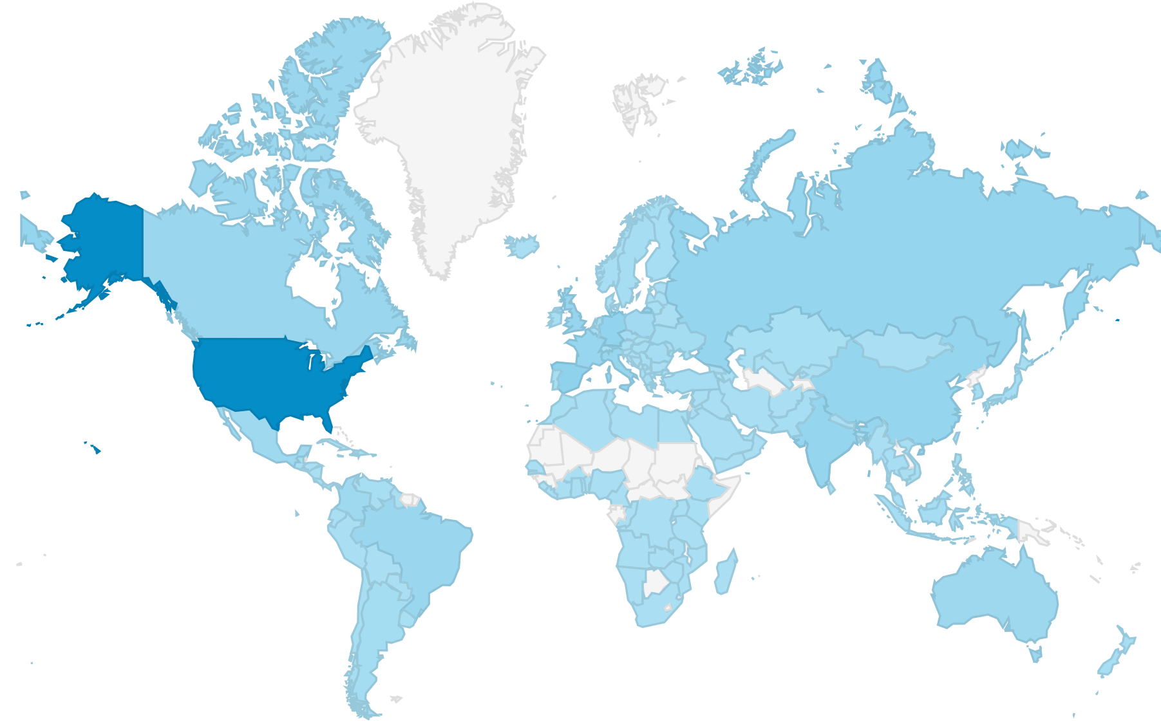
Over 12,000 daily active users from 151 countries

Slide 25
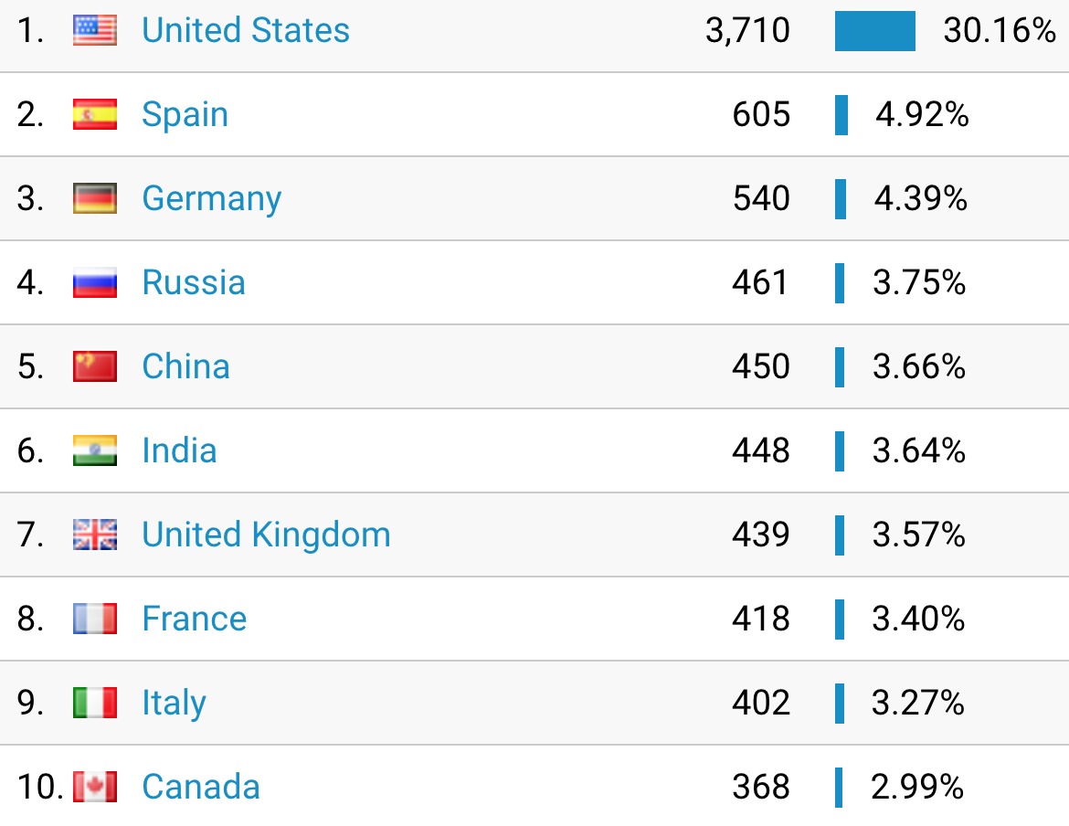

Slide 26
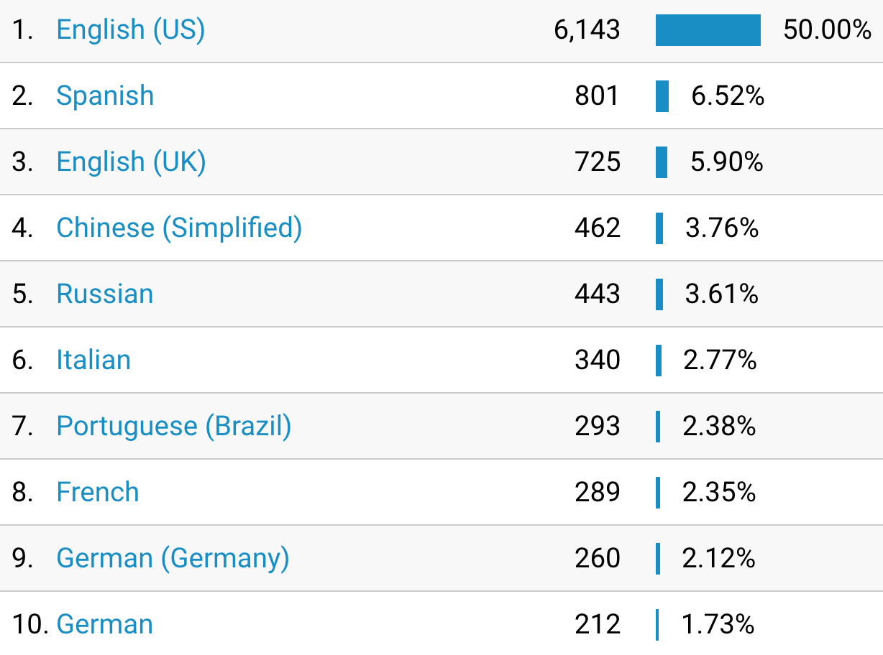

Slide 27
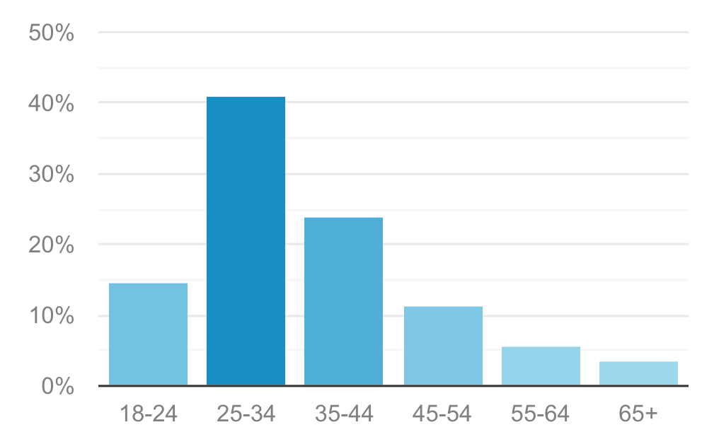

Slide 28
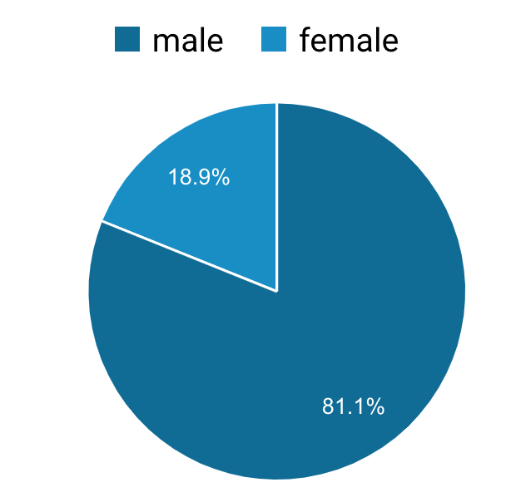

Slide 29
Designing for Growth In-the-wild
Design for good user experience: polish product, remove bugs, avoid long onboarding surveys and excessive experience sampling

Slide 30
Designing for Growth In-the-wild
A/B test to find good defaults that maximize retention

Slide 31
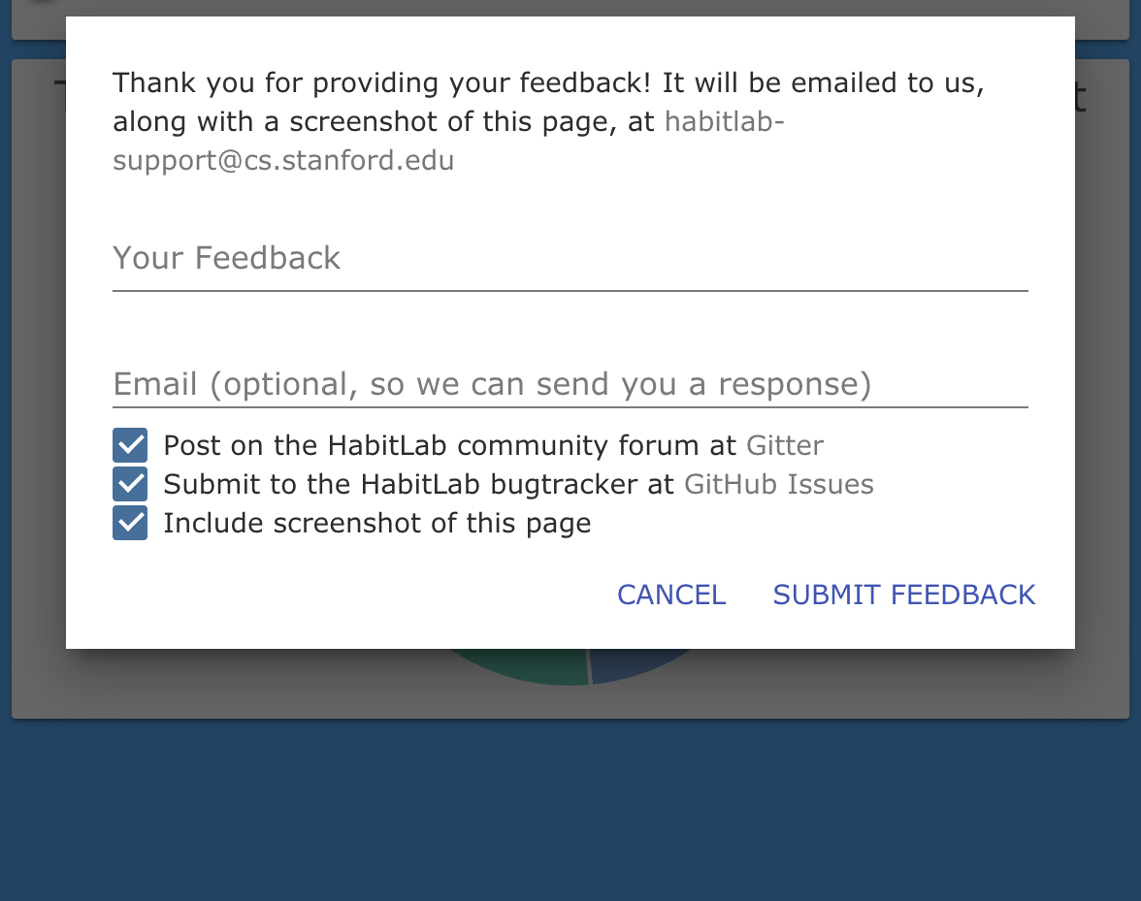
Designing for Growth In-the-wild
Give people plenty of opportunities to leave feedback

Slide 32
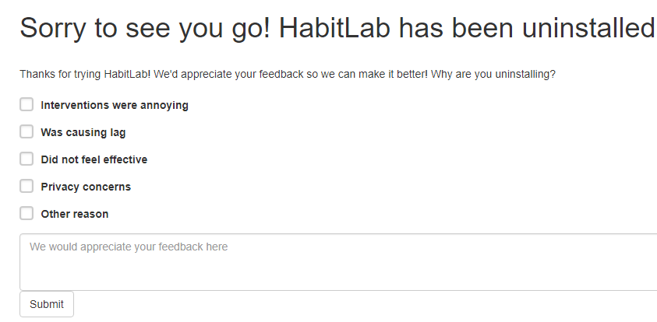
Designing for Growth In-the-wild
Give people plenty of opportunities to leave feedback

Slide 33
Designing for Growth In-the-wild
Give people plenty of opportunities to leave feedback

Slide 34
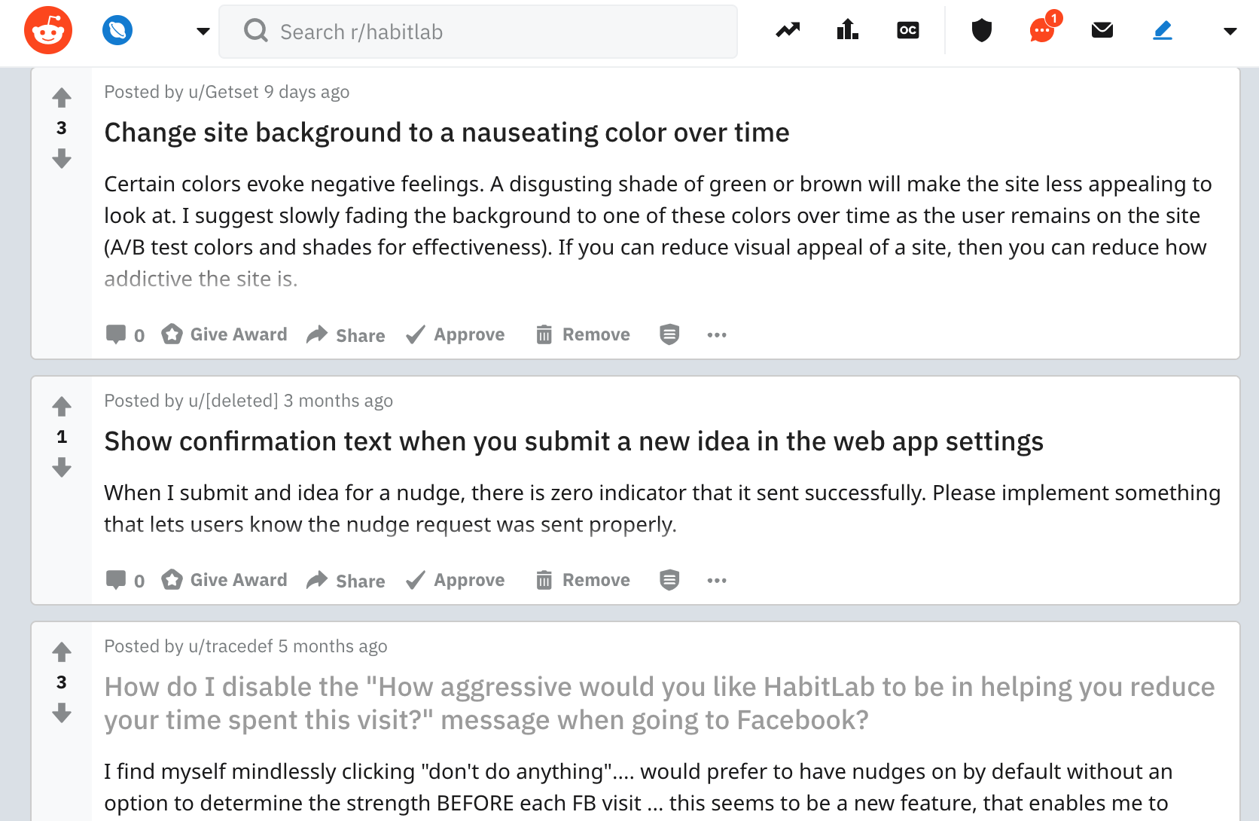
Designing for Growth In-the-wild
Give people plenty of opportunities to leave feedback

Slide 35
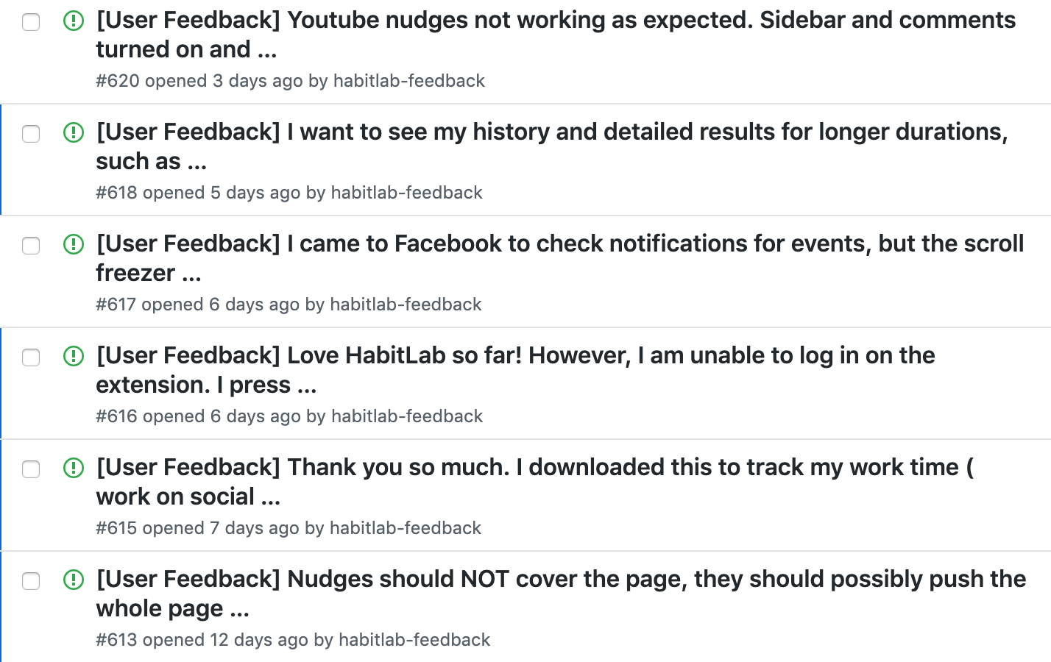
Designing for Growth In-the-wild
Give people plenty of opportunities to leave feedback

Slide 36
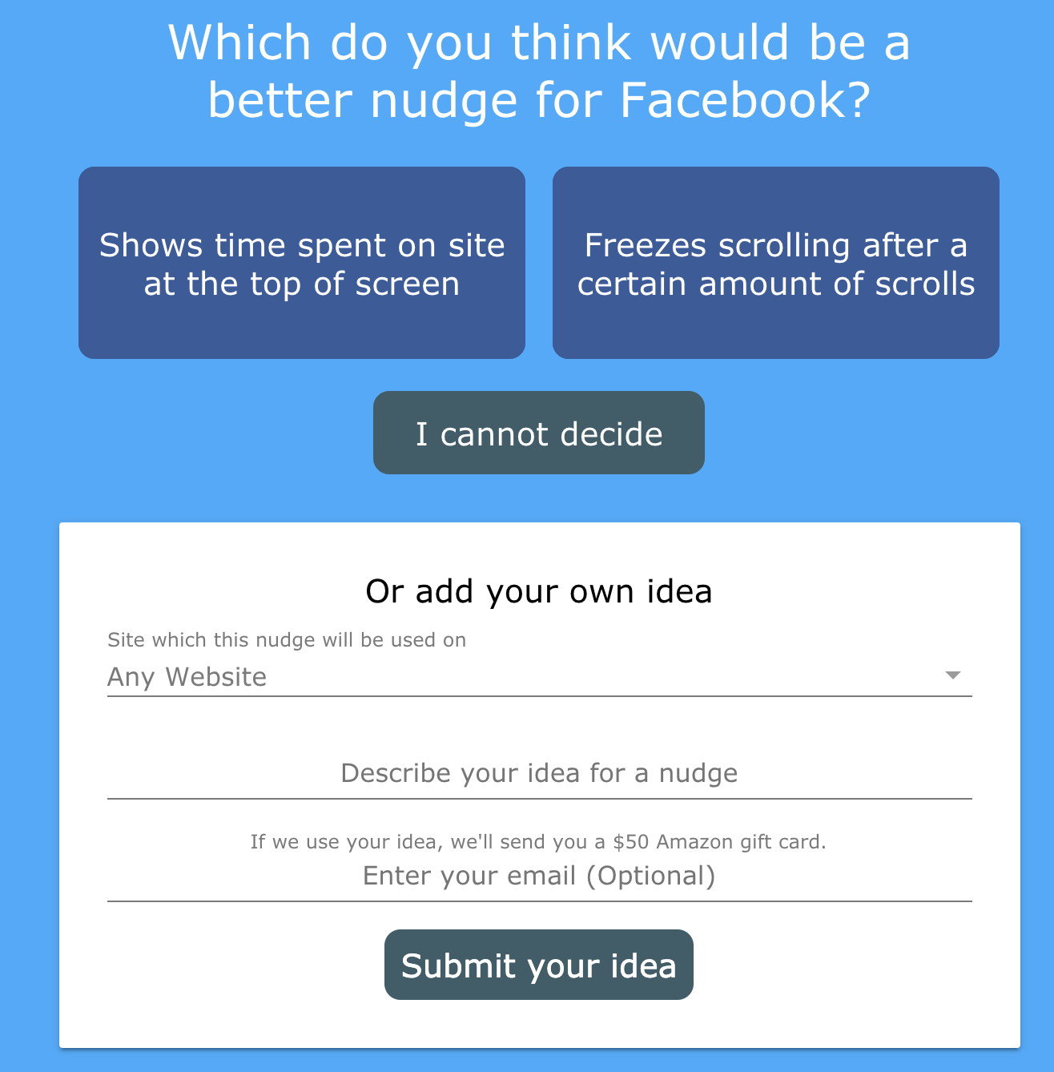
Designing for Growth In-the-wild
Give people opportunities to contribute: ideas

Slide 37
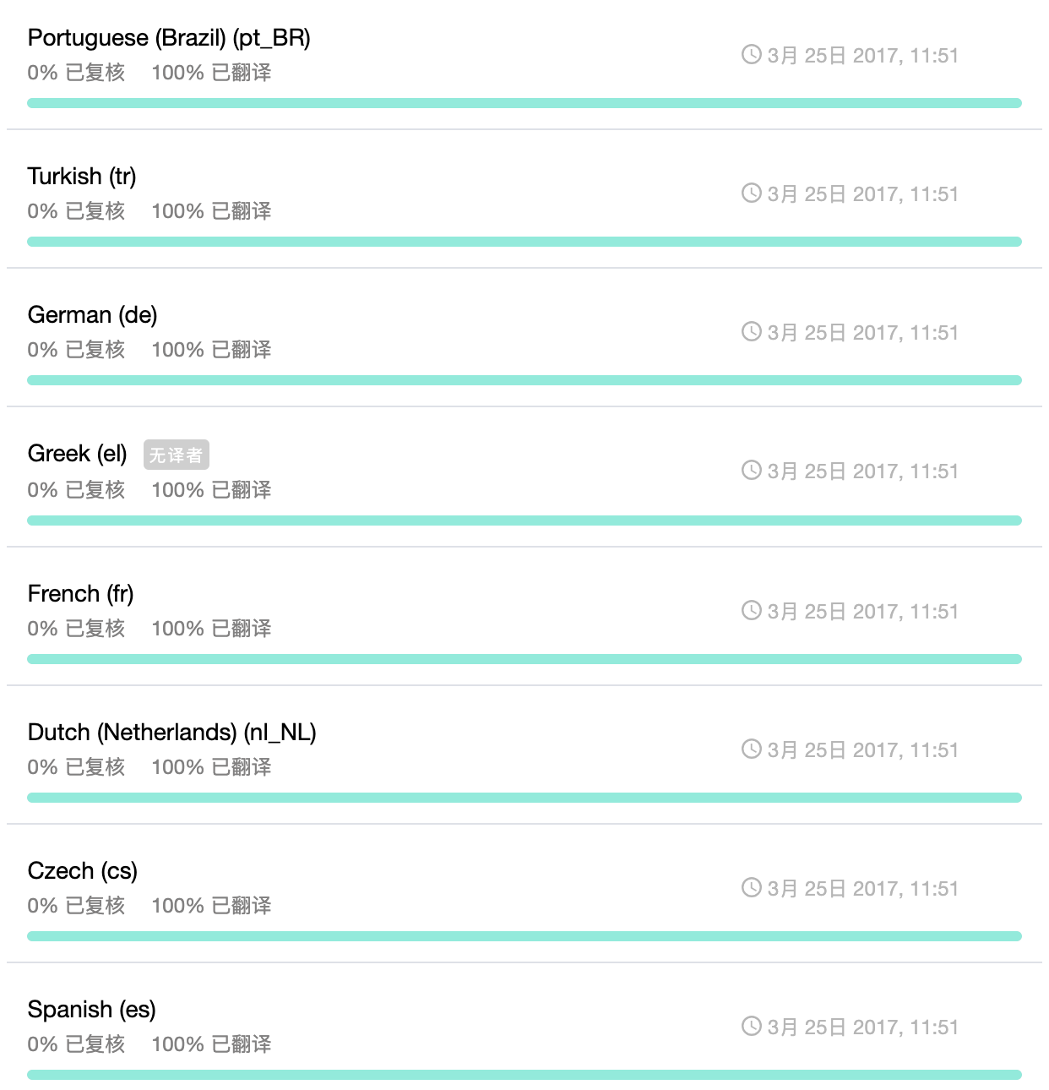
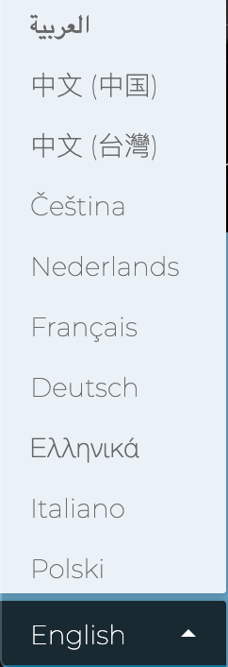
Designing for Growth In-the-wild
Give people opportunities to contribute: internationalization

Slide 38
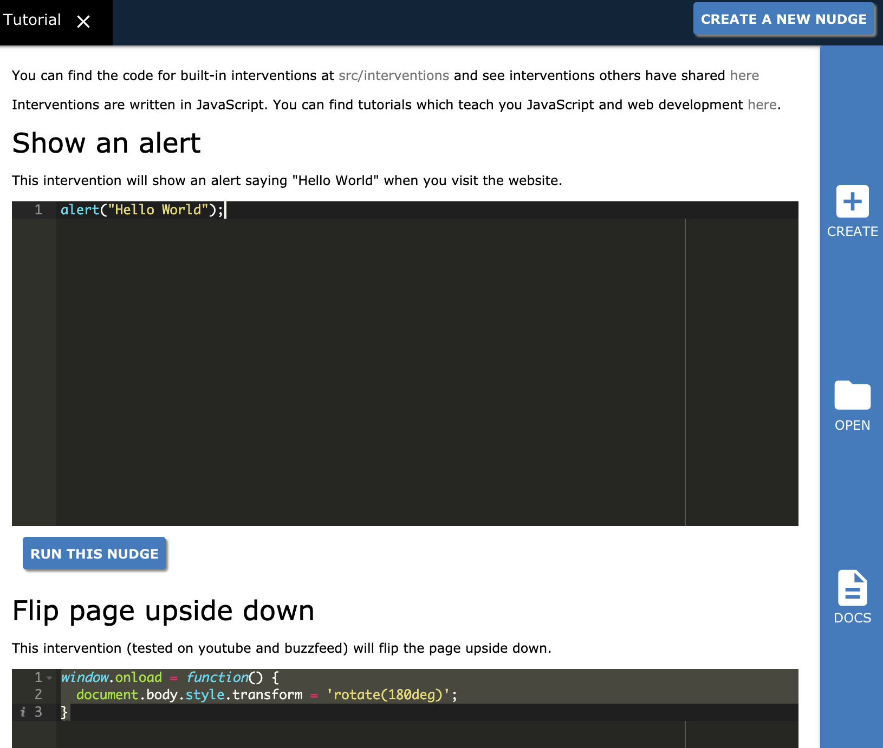
Designing for Growth In-the-wild
Give people opportunities to contribute: code

Slide 39
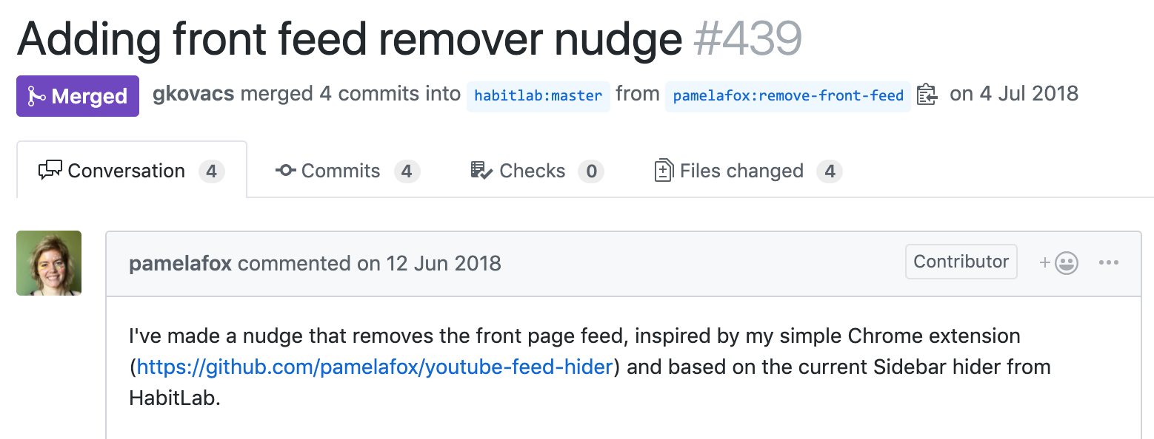
Designing for Growth In-the-wild
Give people opportunities to contribute: code

Slide 40
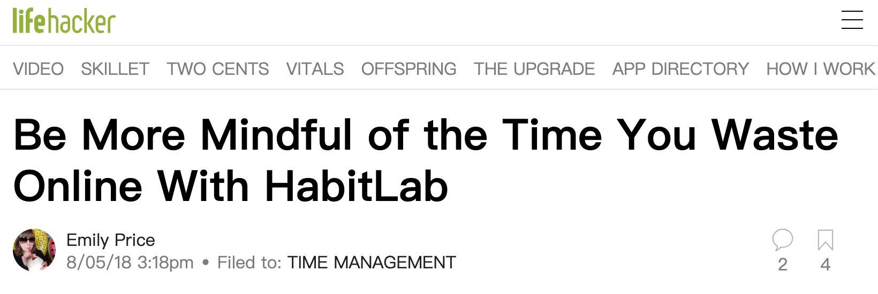
Designing for Growth In-the-wild
Ultimately, a lot depends on press and factors outside your control

Slide 41
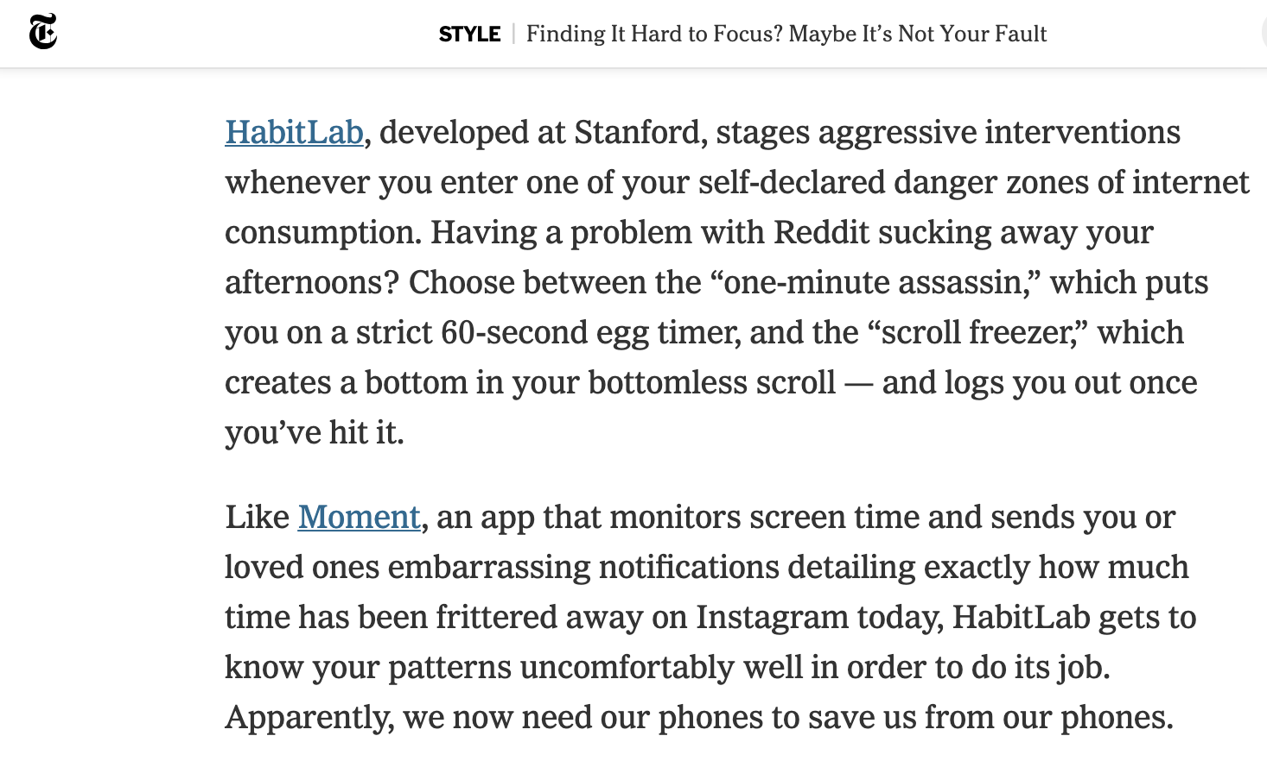
Designing for Growth In-the-wild
Ultimately, a lot depends on press and factors outside your control

Slide 42
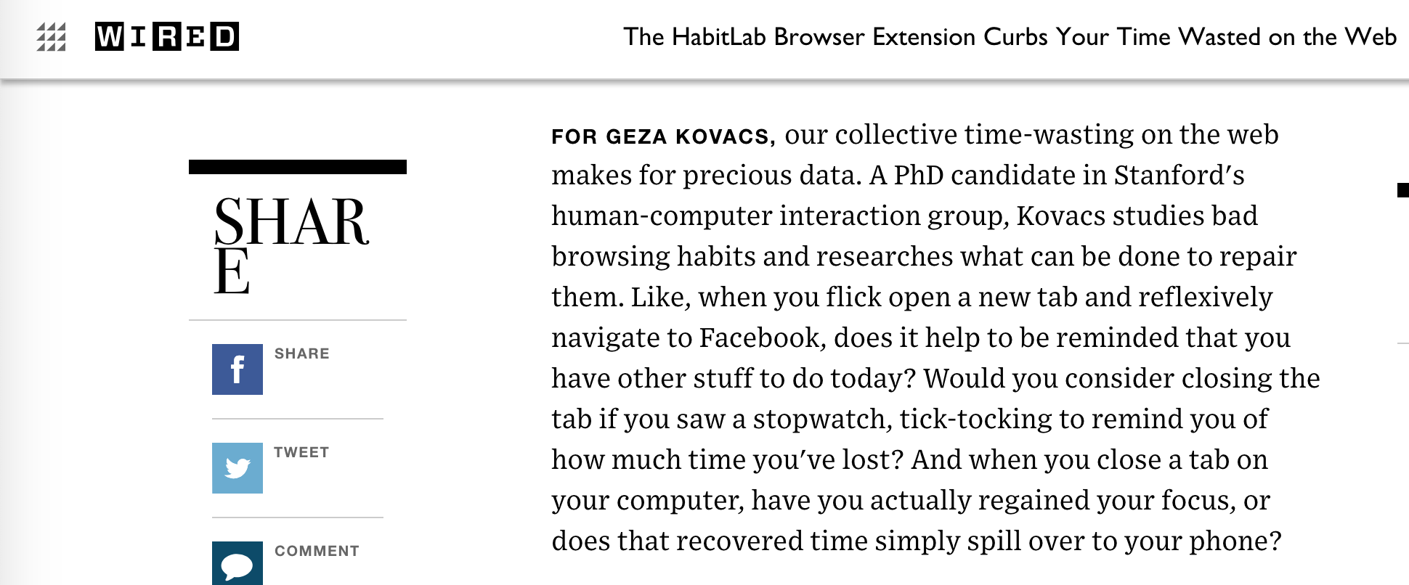
Designing for Growth In-the-wild
Ultimately, a lot depends on press and factors outside your control

Slide 43
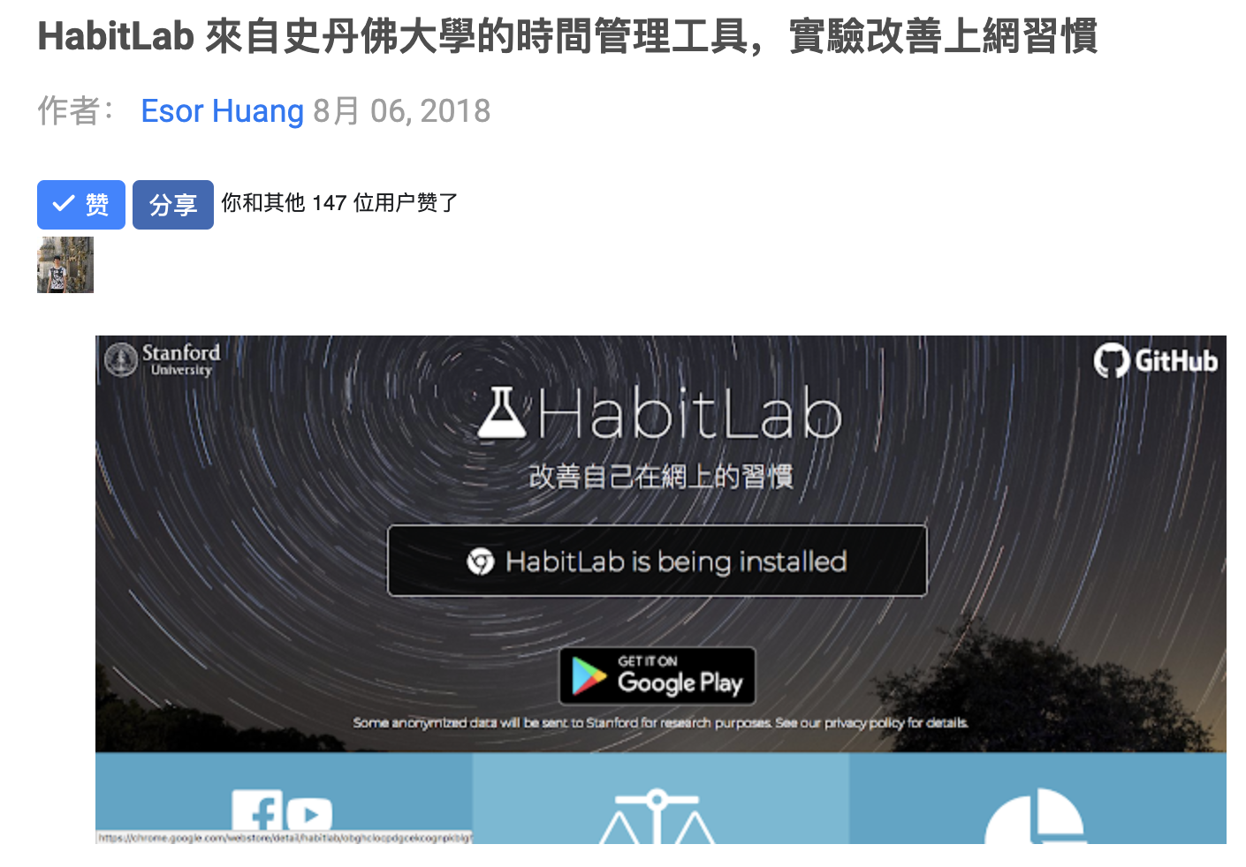

Designing for Growth In-the-wild
Ultimately, a lot depends on press and factors outside your control

Slide 44
HabitLab: Our in-the-wild behavior change platform
Outcomes
Does effectiveness remain constant over time?
What externalities exist?
Interventions
How do users’ preferences change over time?
Rotating Online Behavior Change Interventions Increases Effectiveness But Also Increases Attrition (CSCW 2018)

Slide 45

Behavior change interventions suffer from declined engagement over time
Paul Krebs, James O Prochaska, and Joseph S Rossi. 2010. A meta-analysis of computer-tailored interventions for health behavior change. Preventive medicine 51, 3-4 (2010), 214–221

Slide 46

Novelty effects can provide temporary boosts in engagement
Reza Kormi nouri, Lars Goran Nilson, and Nobuo Ohta. [n. d.]. The novelty effect: Support for the Novelty Encoding Hypothesis. Scandinavian Journal of Psychology

Slide 47
Existing behavior change systems tend to use static interventions

Slide 48

[RQ] Can a strategy of rotating interventions improve effectiveness?

Slide 49

[H1] Static interventions suffer from decreased effectiveness over time

Slide 50

[H2] Rotation will increase intervention effectiveness

Slide 51
Rotating Online Behavior Change Interventions Increases Effectiveness But Also Increases Attrition (CSCW 2018)
Rotating vs static intervention strategies
Study 1: Within subjects
Study 2: Between subjects
Qualitative feedback
Study 3: Improving users’ mental models about rotating interventions
HabitLab: Our in-the-wild behavior change platform
Do interventions remain effective as time passes?
What are the side effects of interventions?
How do users’ preferences change over time?

Slide 52
Compare rotating and static intervention strategies, in terms of:
Effectiveness of interventions over time (daily time on sites)
Attrition rates (time until uninstall)

Slide 53
Within-subjects design, 217 participants

Slide 54
Within-subjects design, 217 participants
Conditions: on some days, users saw the same intervention (static), on others, interventions changed each visit (rotation)

Slide 55
Within-subjects design, 217 participants
Conditions: on some days, users saw the same intervention (static), on others, interventions changed each visit (rotation)
Conditions were organized into blocks of 1, 3, 5, 7 days
A block of 1 day static followed by 1 day rotation
S
R
Day 1 2

Slide 56
Within-subjects design, 217 participants
Conditions: on some days, users saw the same intervention (static), on others, interventions changed each visit (rotation)
Conditions were organized into blocks of 1, 3, 5, 7 days
A block of 3 days rotation followed by 3 days static
S
R
R
R
R
S
S
S
Day 1 2 3 4 5 6 7 8

Slide 57
Within-subjects design, 217 participants
Conditions: on some days, users saw the same intervention (static), on others, interventions changed each visit (rotation)
Conditions were organized into blocks of 1, 3, 5, 7 days
A block of 5 days rotation followed by 5 days static
S
R
R
R
R
S
S
S
R
R
R
R
R
S
S
S
S
S
Day 1 2 3 4 5 6 7 8 9 10 11 12 13 14 15 16 17 18

Slide 58
Do static interventions decline in effectiveness over time?
Linear Mixed Model
Fixed effects:
#days intervention seen
Random effects:
User ID, Domain
Dependent variable:
Time spent on domain that day (log)

Slide 59
Time spent on sites increases over time with static interventions (decline in effectiveness)
 | Log time spent per day (dependent variable)
# days static intervention seen | 0.225 (p < 0.05)
Intercept | 4.759
Observations | 124
Interpretation (via exponentiation):
Day 1: 116 seconds per site
Day 2: 146 seconds per site
Day 3: 183 seconds per site

Slide 60
Does rotation reduce time spent?
Linear Mixed Model
Fixed effects:
Condition (static or rotation), Block length
Random effects:
User ID, Domain
Dependent variable:
Time spent on domain that day (log)

Slide 61
 | Log time spent per day (Dependent variable)
Rotation (baseline: static) | -0.417 (p < 0.05)
Intercept | 4.981
Observations | 370
Daily time on sites reduced in the rotation condition
Interpretation (via exponentiation):
Static: 146 seconds per site daily
Rotation: 96 seconds per site daily

Slide 62
Does rotation increase attrition?
Cox hazard regression
Predicting survival probability as a function of condition (static or rotation), within the first block

Slide 63
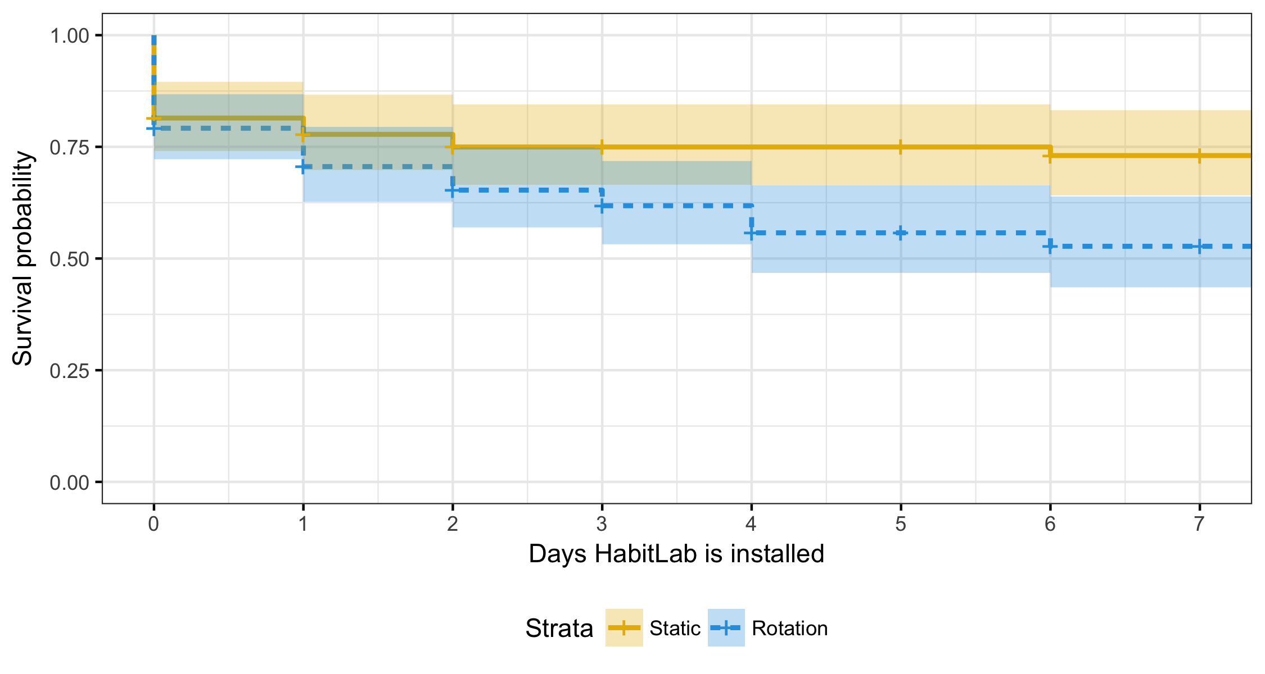
Rotating interventions increases attrition
Survival Probability
Days HabitLab remains installed
Static interventions
Rotating interventions
Log hazard ratio for rotation condition: 0.544 (p < 0.05)

Slide 64
Rotating interventions increases attrition
Static: 74% after a week
Survival Probability
Days HabitLab remains installed
Static interventions
Rotating interventions
Log hazard ratio for rotation condition: 0.544 (p < 0.05)

Slide 65
Rotating interventions increases attrition
Static: 74% after a week
Rotation: 52% after a week
Survival Probability
Days HabitLab remains installed
Static interventions
Rotating interventions
Log hazard ratio for rotation condition: 0.544 (p < 0.05)

Slide 66
HabitLab: Our in-the-wild behavior change platform
Do interventions remain effective as time passes?
What are the side effects of interventions?
How do users’ preferences change over time?
Rotating vs static intervention strategies
Study 1: Within subjects
Rotating interventions improves effectiveness but increases attrition
Study 2: Between subjects
Qualitative feedback
Study 3: Improving users’ mental models about rotating interventions

Slide 67
HabitLab: Our in-the-wild behavior change platform
Outcomes
Does effectiveness remain constant over time?
What externalities exist?
Interventions
How do users’ preferences change over time?
Rotating vs static intervention strategies
Study 1: Within subjects
Rotating interventions improves effectiveness but increases attrition
Study 2: Between subjects
Qualitative feedback
Study 3: Improving users’ mental models about rotating interventions

Slide 68
Does rotating between more interventions increase attrition?

Slide 69
Does rotating between more interventions increase attrition?
Between-subjects design, 409 participants, 5 weeks

Slide 70
Does rotating between more interventions increase attrition?
Between-subjects design, 409 participants, 5 weeks
Conditions differ in number of interventions being rotated:
One intervention per site
Half of all available interventions per site (ie, 4 on Facebook)
All available interventions per site (ie, 8 on Facebook)

Slide 71
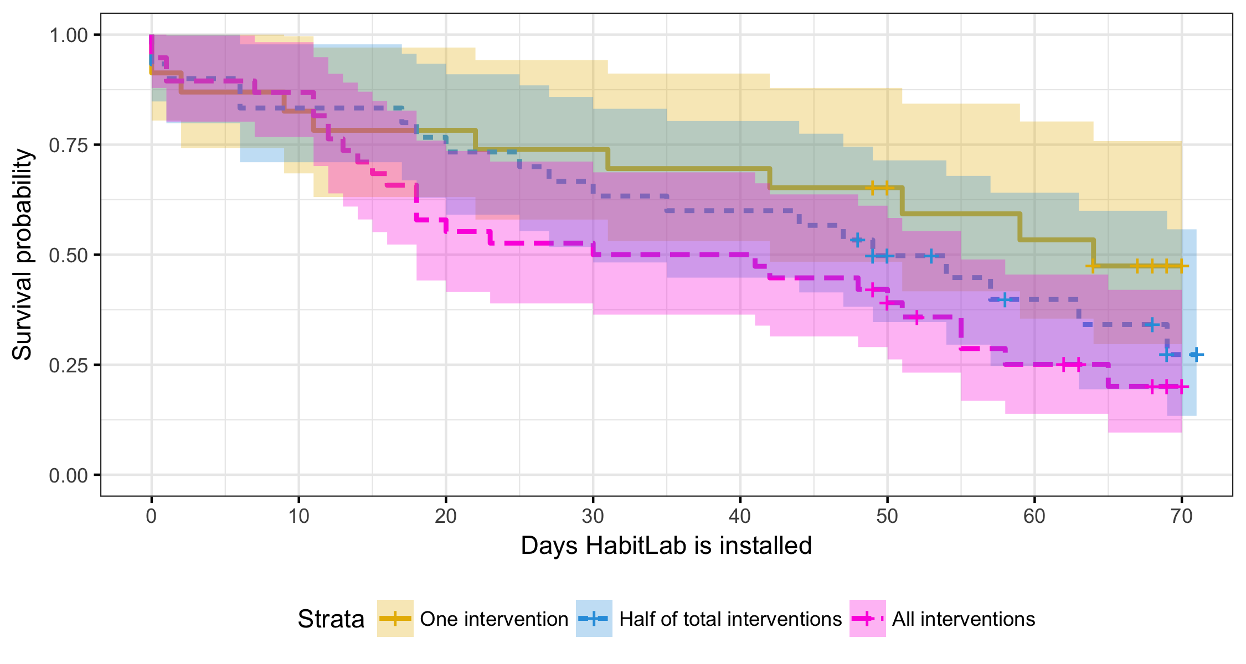
Rotating between interventions increases attrition
Survival Probability
Days HabitLab remains installed
One intervention
Half of total interventions
All interventions

Slide 72
Rotating between interventions increases attrition
Survival Probability
One: 47% after 70 days
Days HabitLab remains installed
One intervention
Half of total interventions
All interventions

Slide 73
Rotating between interventions increases attrition
Survival Probability
One: 47% after 70 days
Half: 27% after 70 days
Days HabitLab remains installed
One intervention
Half of total interventions
All interventions

Slide 74
Rotating between interventions increases attrition
Survival Probability
One: 47% after 70 days
Half: 27% after 70 days
All: 20% after 70 days
Days HabitLab remains installed
One intervention
Half of total interventions
All interventions

Slide 75
Rotating between interventions increases attrition
Survival Probability
One: 47% after 70 days
P < 0.05
Significant
Half: 27% after 70 days
All: 20% after 70 days
Days HabitLab remains installed
One intervention
Half of total interventions
All interventions

Slide 76
HabitLab: Our in-the-wild behavior change platform
Outcomes
Does effectiveness remain constant over time?
What externalities exist?
Interventions
How do users’ preferences change over time?
Rotating vs static intervention strategies
Study 1: Within subjects
Rotating interventions improves effectiveness but increases attrition
Study 2: Between subjects
Rotation itself causes attrition
Qualitative feedback
Study 3: Improving users’ mental models about rotating interventions

Slide 77
HabitLab: Our in-the-wild behavior change platform
Outcomes
Does effectiveness remain constant over time?
What externalities exist?
Interventions
How do users’ preferences change over time?
Rotating vs static intervention strategies
Study 1: Within subjects
Rotating interventions improves effectiveness but increases attrition
Study 2: Between subjects
Rotation itself causes attrition
Qualitative feedback
Study 3: Improving users’ mental models about rotating interventions

Slide 78
Collected uninstall feedback to understand reasons for attrition

Slide 79
Collected uninstall feedback to understand reasons for attrition
Incorrect mental models
Didn’t seem what I was expected. Installed two minutes ago and removed it
Dissatisfaction with particular interventions
Mostly it was the bar covering up facebook message indicators

Slide 80
Why did rotating interventions increase attrition?
Violation of mental models
Users lack sense of control

Slide 81
HabitLab: Our in-the-wild behavior change platform
Do interventions remain effective as time passes?
What are the side effects of interventions?
How do users’ preferences change over time?
Rotating vs static intervention strategies
Study 1: Within subjects
Rotating interventions improves effectiveness but increases attrition
Study 2: Between subjects
Rotation itself causes attrition
Qualitative feedback
Rotation violates mental models
Study 3: Improving users’ mental models about rotating interventions

Slide 82
HabitLab: Our in-the-wild behavior change platform
Outcomes
Does effectiveness remain constant over time?
What externalities exist?
Interventions
How do users’ preferences change over time?
Rotating vs static intervention strategies
Study 1: Within subjects
Rotating interventions improves effectiveness but increases attrition
Study 2: Between subjects
Rotation itself causes attrition
Qualitative feedback
Rotation violates mental models
Study 3: Improving users’ mental models about rotating interventions

Slide 83
Can we reduce attrition when intervention rotation happens?
Developed 2 dialogs shown when an intervention is first seen
Mental model design
User control design

Slide 84
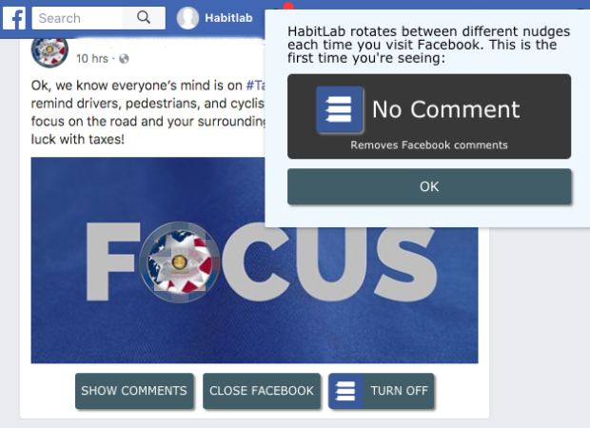
Mental model design

Slide 85
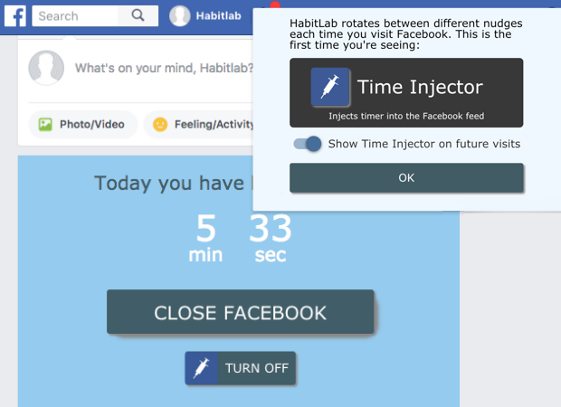
User control design

Slide 86
Between subjects design, 282 participants, 10 days
Conditions differ according to which design is shown when an intervention is seen for the first time:
None: No design shown
Mental model design
User control design

Slide 87
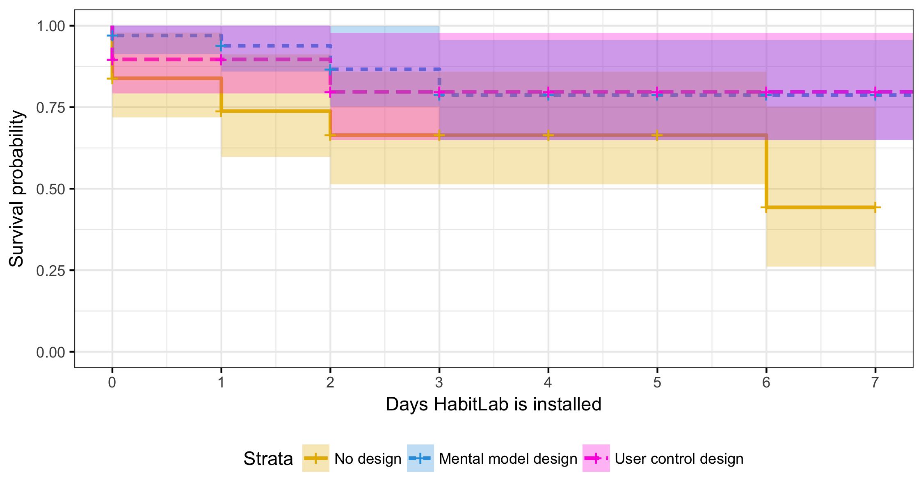
Mental model design reduces attrition by half
Survival probability
Days HabitLab remains installed
No design
Mental model design
User control design
Design | Log hazard ratio
Mental model | -1.015 (p < 0.05)
User control | -0.869
Notes:
Missing y axis label. Specify that when measuring attrition we are all using new users
Literature on just on time interventions. Klanska schuller

Slide 88
Mental model design reduces attrition by half
Survival probability
None: 43% after 7 days
Days HabitLab remains installed
No design
Mental model design
User control design
Design | Log hazard ratio
Mental model | -1.015 (p < 0.05)
User control | -0.869
Notes:
Missing y axis label. Specify that when measuring attrition we are all using new users
Literature on just on time interventions. Klanska schuller

Slide 89
Mental model design reduces attrition by half
Mental model: 78% after 7 days
Survival probability
None: 43% after 7 days
Days HabitLab remains installed
No design
Mental model design
User control design
Design | Log hazard ratio
Mental model | -1.015 (p < 0.05)
User control | -0.869
Notes:
Missing y axis label. Specify that when measuring attrition we are all using new users
Literature on just on time interventions. Klanska schuller

Slide 90
Mental model design reduces attrition by half
User control: 78% after 7 days
Mental model: 78% after 7 days
Survival probability
None: 43% after 7 days
Days HabitLab remains installed
No design
Mental model design
User control design
Design | Log hazard ratio
Mental model | -1.015 (p < 0.05)
User control | -0.869
Notes:
Missing y axis label. Specify that when measuring attrition we are all using new users
Literature on just on time interventions. Klanska schuller

Slide 91
Mental model design reduces attrition by half
User control: 78% after 7 days
Mental model: 78% after 7 days
Survival probability
Significant
Significant
None: 43% after 7 days
Days HabitLab remains installed
No design
Mental model design
User control design
Design | Log hazard ratio
Mental model | -1.015 (p < 0.05)
User control | -0.869
Notes:
Missing y axis label. Specify that when measuring attrition we are all using new users
Literature on just on time interventions. Klanska schuller

Slide 92
HabitLab: Our in-the-wild behavior change platform
Outcomes
Does effectiveness remain constant over time?
What externalities exist?
Interventions
How do users’ preferences change over time?
Rotating vs static intervention strategies
Study 1: Within subjects
Rotating interventions improves effectiveness but increases attrition
Study 2: Between subjects
Rotation itself causes attrition
Qualitative feedback
Rotation violates mental models
Study 3: Improving users’ mental models about rotating interventions
Our design halves attrition

Slide 93
Rotating Online Behavior Change Interventions Increases Effectiveness But Also Increases Attrition (CSCW 2018)
Static interventions decline in effectiveness over time
Rotating interventions improves effectiveness but increases attrition
Attrition may be due to incorrect mental models and lack of control
We can reduce attrition with a simple design that improves users’ mental models
HabitLab: Our in-the-wild behavior change platform
Outcomes
Does effectiveness remain constant over time?
What externalities exist?
Interventions
How do users’ preferences change over time?

Slide 94
HabitLab: Our in-the-wild behavior change platform
Outcomes
Does effectiveness remain constant over time?
What externalities exist?
Interventions
How do users’ preferences change over time?
Conservation of Procrastination: Do Productivity Interventions Save Time or Just Redistribute It? (CHI 2019)

Slide 95

Users use productivity tools to help them reduce time online

Slide 96
Is that time actually saved, or just redirected to other unproductive activities?

Slide 97

We often assume that intervention effects are isolated

Slide 98

We often assume that intervention effects are isolated

Slide 99
We often assume that intervention effects are isolated

Slide 100

We often assume that intervention effects are isolated

Slide 101


We often assume that intervention effects are isolated

Slide 102
What if the time you saved is just shifted elsewhere?

Slide 103

We have a limited supply of willpower
Laura Dabbish, Gloria Mark, and Víctor M González. 2011. Why do I keep interrupting myself?: Environment, Habit and Self-interruption. In Proceedings of the SIGCHI Conference on Human Factors in Computing Systems. ACM, 3127–3130.
Roy E Baumeister, Ellen Bratslavsky, Mark Muraven, and Dianne M Tice. 1998. Ego Depletion: Is the Active Self a Limited Resource? Journal of Personality and Social Psychology 74, 5 (1998), 1252–1265.
We need breaks and downtime

Slide 104
Is there a conservation-of-procrastination effect?
Does reducing time on one site or app increase time on others?

Slide 105
Is there a conservation-of-procrastination effect?
Does reducing time on one device increase time on others?

Slide 106
Do interventions have benefits outside the apps they were targeting?

Slide 107
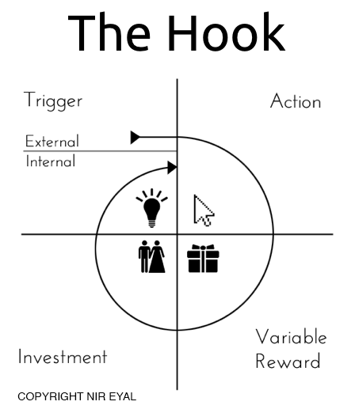
Apps are designed to be habit-building
Results in habit loop of constantly visiting sites or checking phones

Slide 108
Does breaking habit loops result in further decreases in time spent elsewhere?
Does reducing time on one app or site decrease time on others?

Slide 109
Does breaking habit loops result in further decreases in time spent elsewhere?
Does reducing time on one device decrease time on the other?

Slide 110
RQ1: Do interventions on one site or app influence time spent on other sites and apps?

Slide 111
RQ1: Do interventions on one site or app influence time spent on other sites and apps?

Slide 112
RQ1: Do interventions on one site or app influence time spent on other sites and apps?
Isolation
Redistribution
Reduction

Slide 113
RQ2: Do interventions on one device influence time spent on other devices?
Isolation
Redistribution
Reduction

Slide 114
HabitLab: Our in-the-wild behavior change platform
Outcomes
Does effectiveness remain constant over time?
What externalities exist?
Interventions
How do users’ preferences change over time?
Conservation of Procrastination: Do Productivity Interventions Save Time or Just Redistribute It? (CHI 2019)
Are interventions effective at reducing time on the focal goal?
RQ1: Is time redistributed to other sites on the same platform?
RQ2: Is time redistributed across devices?

Slide 115
Are interventions effective? (Method)
For each goal, we randomly assign it to one of 2 conditions each week:
Frequent
An intervention is shown every visit
(each site visit for browser, each app visit on android)
Infrequent
An intervention is shown on 20% of visits

Slide 116
Are interventions effective? (Method)
Compare daily time spent on days in the frequent vs infrequent conditions, for each goal

Slide 117
Are interventions effective? (Method)
Compare daily time spent on days in the frequent vs infrequent conditions, for each goal
5.8 weeks with 1034 users on browser (n=22,462 days), and 876 users on mobile (n=26,273 days)

Slide 118
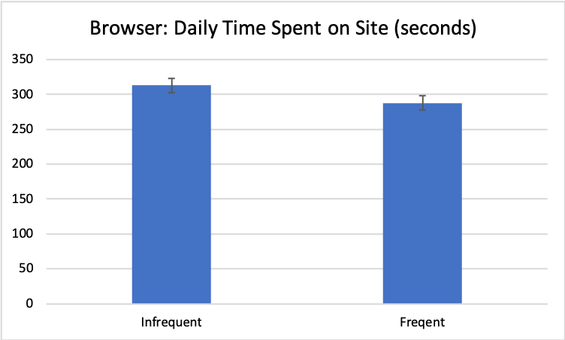
Interventions are effective on both platforms
7.3% reduction in daily time spent on browser version, on frequent weeks. Statistically significant (p < 0.001)

Slide 119
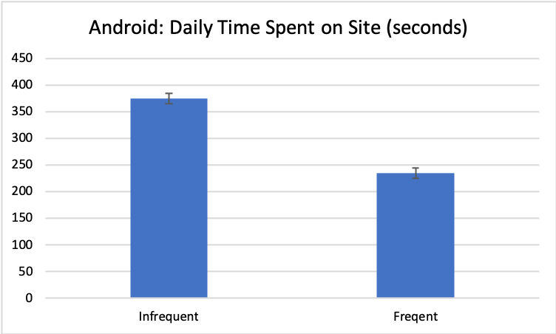
Interventions are effective on both platforms
37.2% reduction in daily time spent on android version, on frequent weeks. Statistically significant (p < 0.001)

Slide 120
HabitLab: Our in-the-wild behavior change platform
Outcomes
Does effectiveness remain constant over time?
What externalities exist?
Interventions
How do users’ preferences change over time?
Are interventions effective at reducing time on the focal goal?
Effective on both browser + mobile
RQ1: Is time redistributed to other sites on the same platform?
RQ2: Is time redistributed across devices?

Slide 121
HabitLab: Our in-the-wild behavior change platform
Outcomes
Does effectiveness remain constant over time?
What externalities exist?
Interventions
How do users’ preferences change over time?
Are interventions effective at reducing time on the focal goal?
Effective on both browser + mobile
RQ1: Is time redistributed to other sites on the same platform?
RQ2: Is time redistributed across devices?

Slide 122
Is time redistributed within platform? (Method)
We developed a metric of how intense interventions are this day (intensity)
Percentage of sessions on a goal that triggered an intervention

Slide 123
Is time redistributed within platform? (Method)
We developed a metric of how intense interventions are this day (intensity)
Percentage of sessions on a goal that triggered an intervention.
E.g. if visited Facebook 10x, and saw 0 interventions, then intensity=0
Intensity=0

Slide 124
Is time redistributed within platform? (Method)
We developed a metric of how intense interventions are this day (intensity)
Percentage of sessions on a goal that triggered an intervention.
E.g. if visited Facebook 10x, and saw 3 interventions, then intensity=0.3
Intensity=0.3

Slide 125
Is time redistributed within platform? (Method)
We developed a metric of how intense interventions are this day (intensity)
Percentage of sessions on a goal that triggered an intervention.
Verified that on days where intensity is higher, overall total time on goal sites is significantly lower on both platforms
Intensity=0.3

Slide 126
Is time redistributed within platform? (Method)
To manipulate intensity, we randomly assign each goal to have either frequent or infrequent interventions each week, resulting in a continuous intensity value from 0 to 1
Frequent
An intervention is shown every visit
(each site visit for browser, each app visit on android)
Infrequent
An intervention is shown on 20% of visits

Slide 127
Is time redistributed within platform? (Method)
On days when intensity is higher, what is the effect on the time spent on non-goal apps and sites?
LMM (Linear Mixed Model) structure
Dependent variable | Total time on non-goal sites (log)
Fixed effects | Intensity
Random effects | User

Slide 128
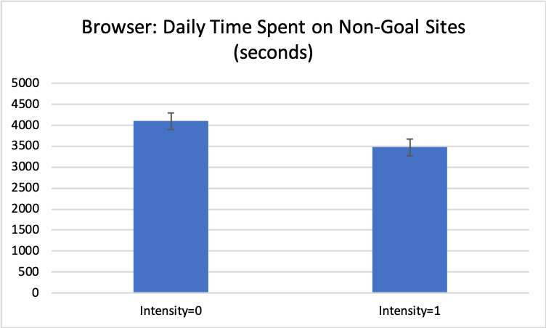
Browser: reduction of time spent on other sites when intensity is higher
15% reduction in time spent when intensity increases from 0→1 (p < 0.0001)

Slide 129
Mobile: No significant effect of time on one app on other apps

Slide 130
RQ1: Do interventions on one site/app influence time spent on other sites/apps?
Isolation
Conservation
Reduction

Slide 131
RQ1: Do interventions on one site/app influence time spent on other sites/apps?
Isolation
Conservation
Reduction
Browser

Slide 132
RQ1: Do interventions on one site/app influence time spent on other sites/apps?
Isolation
Mobile
Conservation
Reduction
Browser

Slide 133



Why was there a reduction effect on browser?
Aggregator sites such as Facebook often link to other domains
By reducing visits and time on Facebook, we reduce time on other domains

Slide 134



Why was there no effect on mobile?
Mobile goal apps were mostly messaging-oriented, not aggregators
Sessions were short and followed by turning off the screen
Screen off
Oulasvirta, Antti, et al. "Interaction in 4-second bursts: the fragmented nature of attentional resources in mobile HCI." Proceedings of the SIGCHI conference on Human factors in computing systems. ACM, 2005.

Slide 135
Why was there no effect on mobile?
Many mobile apps such as Facebook embed an in-app browser, so visiting external links remains within the same app
Screen off

Slide 136
HabitLab: Our in-the-wild behavior change platform
Outcomes
Does effectiveness remain constant over time?
What externalities exist?
Interventions
How do users’ preferences change over time?
Are interventions effective at reducing time on the focal goal?
Effective on both browser + mobile
RQ1: Is time redistributed to other sites on the same platform?
Reducing time on one site reduces time elsewhere on browser (reduction) but not mobile (isolation)
RQ2: Is time redistributed across devices?

Slide 137
HabitLab: Our in-the-wild behavior change platform
Outcomes
Does effectiveness remain constant over time?
What externalities exist?
Interventions
How do users’ preferences change over time?
Are interventions effective at reducing time on the focal goal?
Effective on both browser + mobile
RQ1: Is time redistributed to other sites on the same platform?
Reducing time on one site reduces time elsewhere on browser (reduction) but not mobile (isolation)
RQ2: Is time redistributed across devices?

Slide 138
Is time redistributed across devices? (Method)
On days when intensity is higher on one device, what is the effect on total time spent on goal sites on the other device?

Slide 139
Is time redistributed across devices? (Method)
On days when intensity is higher on one device, what is the effect on total time spent on goal sites on the other device?
Limited to participants using HabitLab on both platforms (60 participants, n=429 days)

Slide 140
Is time redistributed across devices? (Method)
On days when intensity is higher on one device, what is the effect on total time spent on goal sites on the other device?
Limited to participants using HabitLab on both platforms (60 participants, n=429 days)
LMM (Linear Mixed Model) structure
Dependent variable | Total time on other device (log)
Fixed effects | Intensity on this device
Random effects | User

Slide 141
Time is not redistributed across devices
Effects of browser intensity on mobile: No significant effect (p>.5)
Effects of mobile intensity on browser: No significant effect (p>.5)

Slide 142
RQ2: Do interventions on one device influence time spent on other devices?
Isolation
Redistribution
Reduction

Slide 143
RQ2: Do interventions on one device influence time spent on other devices?
Isolation
Mobile → Browser
Browser → Mobile
Redistribution
Reduction

Slide 144
Why were there no cross-device effects?
Laptops and phones are used in different contexts
Unlike browsers, there are no cross-device “links” – few apps/sites prompt you to start using the other device

Slide 145
HabitLab: Our in-the-wild behavior change platform
Outcomes
Does effectiveness remain constant over time?
What externalities exist?
Interventions
How do users’ preferences change over time?
Are interventions effective at reducing time on the focal goal?
Effective on both browser + mobile
RQ1: Is time redistributed to other sites on the same platform?
Reducing time on one site reduces time elsewhere on browser (reduction) but not mobile (isolation)
RQ2: Is time redistributed across devices?
Time is not redistributed across devices (isolation hypothesis)

Slide 146
Discussion and implications
We did not observe negative secondary effects of productivity interventions (on other apps, sites, or devices)
On browsers, there’s actually a reduction elsewhere, from reducing time on sites (likely due to aggregator sites)

Slide 147
Discussion and implications
When designing interventions, we should consider effects not just on the targeted behavior, but the workflow as a whole

Slide 148
Limitations
Only monitoring time on phones and browsers
Cannot observe if time is being redistributed to non-digital activities
Only studied productivity domain
“Absence of negative secondary effects” may not generalize to other behavior change domains

Slide 149
Does reducing time via interventions influence time spent elsewhere?

Slide 150
Isolation
Does reducing time via interventions influence time spent elsewhere?
Within-device: reduction on browser
Redistribution
Reduction
Browser

Slide 151
Isolation
Mobile
Does reducing time via interventions influence time spent elsewhere?
Within-device: reduction on browser, but not mobile
Redistribution
Reduction
Browser

Slide 152
Isolation
Mobile → Browser
Browser → Mobile
Does reducing time via interventions influence time spent elsewhere?
Within-device: reduction on browser, but not mobile
Cross-device: no effects
Redistribution
Reduction

Slide 153
Does reducing time via interventions influence time spent elsewhere?
Within-device: reduction on browser, but not mobile
Due to aggregator sites driving traffic to other sites
Cross-device: no effects

Slide 154
Does reducing time via interventions influence time spent elsewhere?
Within-device: reduction on browser, but not mobile
Due to aggregator sites driving traffic to other sites
Cross-device: no effects
Devices used in different contexts

Slide 155
HabitLab: Our in-the-wild behavior change platform
Outcomes
Does effectiveness remain constant over time?
What externalities exist?
Interventions
How do users’ preferences change over time?
Conservation of Procrastination: Do Productivity Interventions Save Time or Just Redistribute It? (CHI 2019)
Does reducing time via interventions influence time spent elsewhere?
Within-device: reduction on browser, but not mobile
Due to aggregator sites driving traffic to other sites
Cross-device: no effects
Devices used in different contexts
155

Slide 156
HabitLab: Our in-the-wild behavior change platform
Outcomes
Does effectiveness remain constant over time?
What externalities exist?
Interventions
How do users’ preferences change over time?

Slide 158
Users have different expectations for what they want productivity tools to do
In our uninstall feedback form, we had many users who stated interventions were too hard, but others stated that they though the interventions were too easy

Slide 159
Users have different expectations for what they want productivity tools to do
In our uninstall feedback form, we had many users who stated interventions were too hard, but others stated that they though the interventions were too easy
Naive solution: Classify interventions according to difficulty, and ask them during onboarding what difficulty they would prefer

Slide 160
Users have different expectations for what they want productivity tools to do
In our uninstall feedback form, we had many users who stated interventions were too hard, but others stated that they though the interventions were too easy
Naive solution: Classify interventions according to difficulty, and ask them during onboarding what difficulty they would prefer

Slide 161
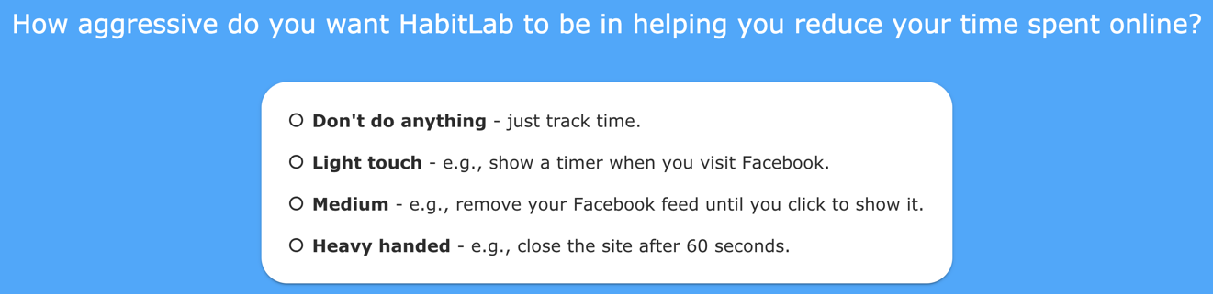

Slide 162
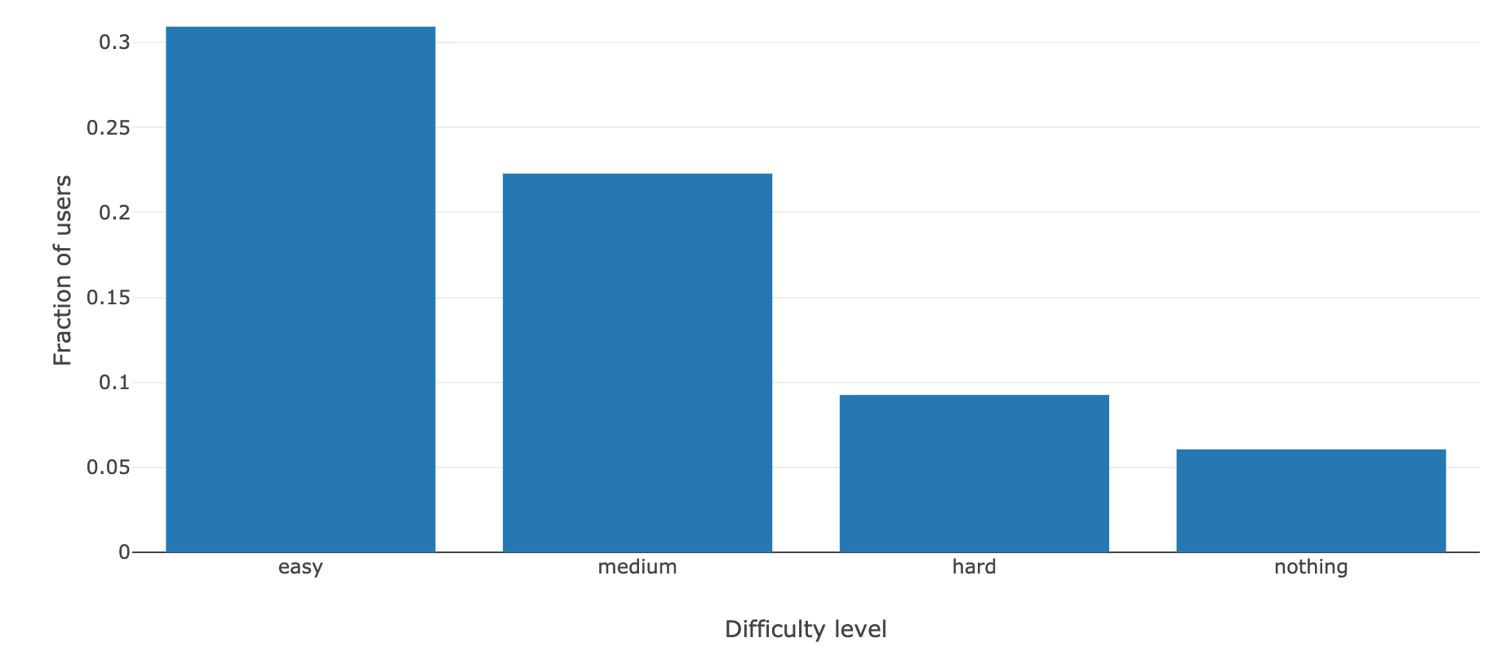
Initial difficulties chosen during onboarding (n = 5114 users)
All pairs statistically significantly different (p < 10^-9, chi-squared tests)

Slide 163
Initial difficulties chosen during onboarding (n = 5114 users)
All pairs statistically significantly different (p < 10^-9, chi-squared tests)
Only 8.8% say they want no interventions

Slide 164
Users initially are optimistic about how difficult they want their interventions
”No intervention” is least frequently chosen during onboarding
HabitLab: Our in-the-wild behavior change platform
Outcomes
Does effectiveness remain constant over time?
What externalities exist?
Interventions
How do users’ preferences change over time?
164

Slide 165
Can users predict during onboarding what interventions will work for them?
Do their preferences change over time?

Slide 166
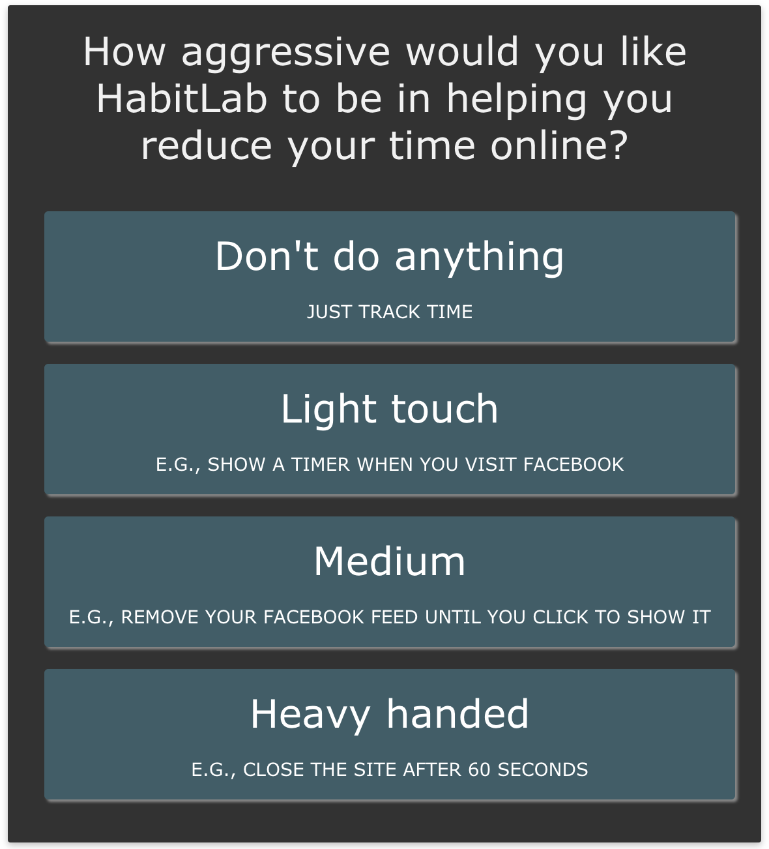
Ask users when they visit site about intervention difficulty preference for this visit

Slide 167
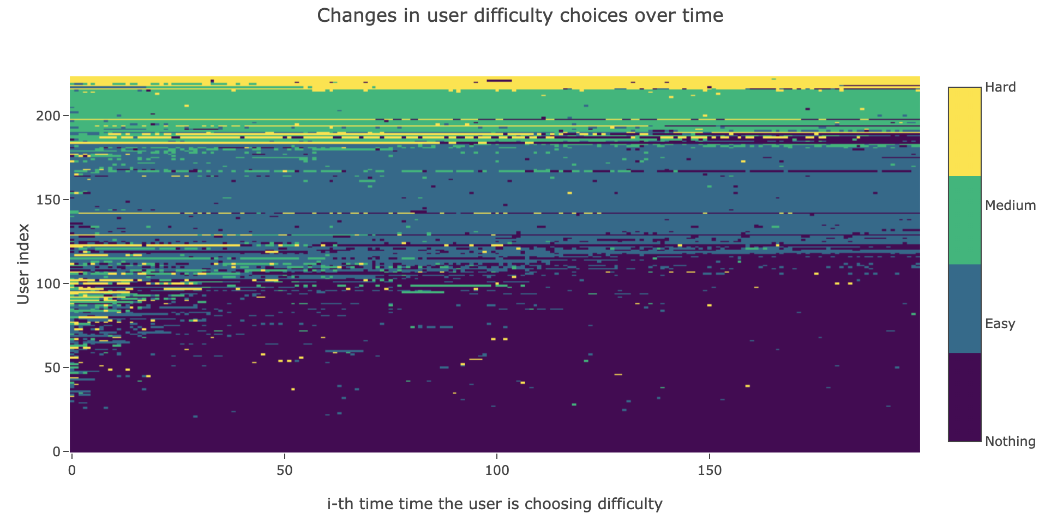

Slide 168
223 users

Slide 169
223 users
Answered at least 200 times

Slide 170
No intervention

Slide 171
Easy
No intervention

Slide 172
Medium
Easy
No intervention

Slide 173
Hard
Medium
Easy
No intervention

Slide 174
Lots of initial exploration between intervention difficulties

Slide 175
After answering 100 times, preferences become mostly stable

Slide 176
Initially, only 29 are consistently choosing “no intervention”

Slide 177
But by the end, 119/223 users (53%) are consistently choosing to have no intervention

Slide 178
Users initially are optimistic about how difficult they want their interventions
”No intervention” is least frequently chosen during onboarding
Intervention difficulty choices decline over time
Half of users eventually choose “no intervention” nearly always
HabitLab: Our in-the-wild behavior change platform
Do interventions remain effective as time passes?
What are the side effects of interventions?
How do users’ preferences change over time?
178

Slide 179
How can we determine when preferred intervention difficulty changes?
If we periodically ask users their preferred intervention difficulty:
How frequently do we need to ask to get accurate results?
What are the costs of asking? (Time? Attrition? Response rate?)

Slide 180

Time it requires users to choose difficulty

Slide 181
Time costs are low: 1.2 seconds to choose difficulty
1.2 seconds

Slide 182

If less than a day has passed since they were last asked, users are less likely to answer

Slide 183
If less than a day has passed since they were last asked, users are less likely to answer
1 day

Slide 184
If less than a day has passed since they were last asked, users are less likely to answer
1 day
Lower response rate if less than a day has passed

Slide 185
If less than a day has passed since they were last asked, users are less likely to answer
1 day
Response rate is level if a day or more has passed

Slide 186

Excessive experience sampling increases attrition

Slide 187
How can we determine when preferred intervention difficulty changes?
If we periodically ask users their preferred intervention difficulty:
What are the costs of asking? (Time? Attrition? Response rate?)
Low time cost (1.2 seconds)
Response rate declines if more frequent than daily
How frequently do we need to ask to get accurate results?

Slide 188

Prediction accuracy declines as sampling frequency decreases
Fraction of times difficulty choice correctly predicted
Sampling frequency, in hours

Slide 189
Prediction accuracy declines as sampling frequency decreases
Day: 80%
Week: 76%
Fraction of times difficulty choice correctly predicted
Sampling frequency, in hours

Slide 190
How can we determine when preferred intervention difficulty changes?
If we periodically ask users their preferred intervention difficulty:
What are the costs of asking? (Time? Attrition? Response rate?)
Low time cost (1.2 seconds)
Response rate declines if more frequent than daily
How frequently do we need to ask to get accurate results?
Daily still gets reasonably high (80%) accuracy

Slide 191
Users initially are optimistic about how difficult they want their interventions
”No intervention” is least frequently chosen during onboarding
Intervention difficulty choices decline over time
Half of users eventually choose “no intervention” nearly always
Desired difficulty can be predicted with periodic experience sampling
HabitLab: Our in-the-wild behavior change platform
Do interventions remain effective as time passes?
What are the side effects of interventions?
How do users’ preferences change over time?
191

Slide 192
User preferences change over time, and our results suggest asking once a day should get a good balance between accuracy vs sampling costs
What do users actually want?

Slide 193


Slide 194


Slide 195
Some users want to be asked every time

Slide 196
Some users want to be asked every time
Other users want to be asked as little as possible

Slide 197


Slide 198
I don’t want an intervention this time, but ask me again next visit

Slide 199
Users initially are overly optimistic about how difficult they want their interventions
”No intervention” is least frequently chosen during onboarding
Intervention difficulty choices decline over time
Half of users eventually choose “no intervention” nearly always
Desired difficulty can be predicted with periodic experience sampling
Hope springs eternal: Don’t want an intervention this visit, but ask next time
HabitLab: Our in-the-wild behavior change platform
Do interventions remain effective as time passes?
What are the side effects of interventions?
How do users’ preferences change over time?
199

Slide 200

People initially overestimate their motivation
Give people choices and many will eventually gravitate to the easy path

Slide 201
What happens when we remove choices?
Asked users for their initial preferences during onboarding
Ignored their preferences and assigned them randomly to various intervention difficulty levels

Slide 202

Randomly assigning difficulty levels has no effect on attrition

Slide 203
Randomly assigning difficulty levels has no effect on attrition
No significant difference in attrition rates
Cox hazard regression, p=0.99

Slide 204

Randomly assigning difficulty levels improves the efficacy of interventions

Slide 205
Randomly assigning difficulty levels improves the efficacy of interventions
Less time spent with hard interventions
Independent samples t-test, p < 10^-58
Less time spent with hard interventions
T-test, p < 10^-58

Slide 206
Users initially are overly optimistic about how difficult they want their interventions
”No intervention” is least frequently chosen during onboarding
Intervention difficulty choices decline over time
Half of users eventually choose “no intervention” nearly always
Desired difficulty can be predicted with periodic experience sampling
Hope springs eternal: Don’t want an intervention this visit, but ask next time
Assigning users harder interventions works to combat these issues
HabitLab: Our in-the-wild behavior change platform
Do interventions remain effective as time passes?
What are the side effects of interventions?
How do users’ preferences change over time?
206

Slide 207
Discussion
Randomly giving users harder interventions seems to perform better than giving users a choice
We would still prefer to respect user preferences

Slide 208
Discussion
Randomly giving users harder interventions seems to perform better than giving users a choice
We would still prefer to respect user preferences
Perhaps we can solve this issue by changing the set of choices?

Slide 209
Discussion
Randomly giving users harder interventions seems to perform better than giving users a choice
We would still prefer to respect user preferences
Perhaps we can solve this issue by changing the set of choices?
Instead of giving a choice between fries or salad, make the choice between broccoli or spinach?

Slide 210
Discussion
Randomly giving users harder interventions seems to perform better than giving users a choice
We would still prefer to respect user preferences
Perhaps we can solve this issue by changing the set of choices?
Instead of giving a choice between fries or salad, make the choice between broccoli or spinach?
Instead of giving a choice to not see an intervention, make the choice between intervention A or B?

Slide 211
Project summary
Users differ in preferences for intervention difficulty
Users initially overestimate their motivation
Give users choices and many will eventually gravitate to the easy path
Giving them harder interventions without asking improves outcomes
Future work: Give users choices without adverse effects

Slide 212
HabitLab: Our in-the-wild behavior change platform
Do interventions remain effective as time passes?
What are the side effects of interventions?
How do users’ preferences change over time?
Conclusion
212

Slide 213
Discussion and Implications
Behavior change systems’ effects on users change constantly
Users’ preferences during onboarding may not be true a week later
Initial observations of effectiveness are subject to novelty effects
There are secondary effects in addition to the targeted outcomes
By reducing time on aggregator sites, time elsewhere is also reduced

Slide 214
Recommendations
Behavior change systems’ effects on users change constantly
Periodically do non-intrusive experience sampling and changes if possible. Don’t assume everything during onboarding will be true forever
There are secondary effects in addition to the targeted outcomes
When measuring how well your behavior change system works, measure outcomes holistically in addition to the target behavior

Slide 215
Future work
There are many behavior change taxonomies organizing theories for how behavior change interventions can work
Which of these theories actually work? How much does theory matter, as opposed to the implementation?
Implement interventions covering a taxonomy (90 total), and measure intervention effectiveness and attrition for each

Slide 216
Future work (more distant future)
We have focused on online behavior change
With the increasing ubiquity of sensors and wearables, could we build an in-the-wild behavior experimentation platform in the physical world?

Slide 217
Thesis Statement
In-the-wild experimentation is a powerful tool to gain insights about behavior change systems at scale – specifically, allowing us to conduct a wide range of studies about interventions and their outcomes.

Slide 218
Acknowledgements
Advisor: Michael Bernstein
Many contributors: Zhengxuan Wu, Jianghezi Zheng, Lisa Liao, Helen Qiu, Drew Gregory, Zilin Ma, Golrokh Emami, Jacob Ray, Matthieu Rolfo, Sarah Sukardi, Matthew Mistele, Julie Ju Young Kim, Wenqin Chen, Radha Jain, James Carroll, Sara Valderrama, Catherine Xu, Esteban Rey, Lewin Cary, Carmelle Millar, Colin Gaffney, Swathi Iyer, Sarah Tieu, Danna Xue, Britni Olina Chau, Na He Jeon, Armando Banuelos, Kaylie Zhu, Brahm Capoor
Labmates in the HCI group

Slide 219
Outcomes
Does effectiveness remain constant as time passes?
What externalities exist?
Interventions
How do users’ preferences change over time?
HabitLab: In-the-wild Behavior Change Experiments at Scale
Effectiveness of static interventions falls over time, rotating them helps
On browsers, reducing time on one site leads to reductions elsewhere
Users initially choose harder interventions, but choice of difficulty falls over time

Slide 220
Backup slides

Slide 221
Examples of research questions we can potentially study using HabitLab
Question type
Questions related to goals of users
Questions related to choice of intervention
Questions related to outcomes of interventions
Observed state
What goals to users have?
What interventions do users choose?
What interventions are effective?
Changes
How and why do user goals change over time?
How and why do intervention choices change over time?
How and why does intervention effectiveness change over time?
Measures
How do users’ stated goals differ from their actual goals?
How do users’ stated intervention preferences differ from their actual choices?
How does effectiveness measured for an intervention differ from overall effect?

Slide 222
Why study online behavior change?
Can measure effectiveness (time spent per visit)
Many interventions possible (can modify sites)
Can frequently alter interventions (can change intervention every visit)

Slide 223

US adults spend 4.2 hours each day
browsing the web and using phone apps
Q1 2018 Nielsen Total Audience Report

Slide 224



